Slide 1
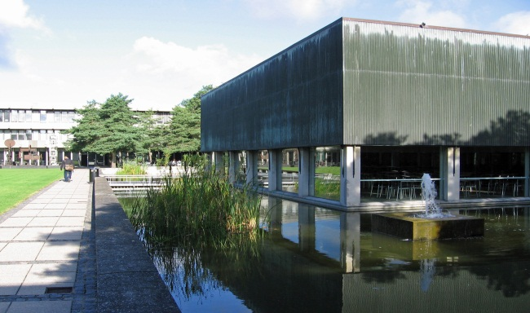
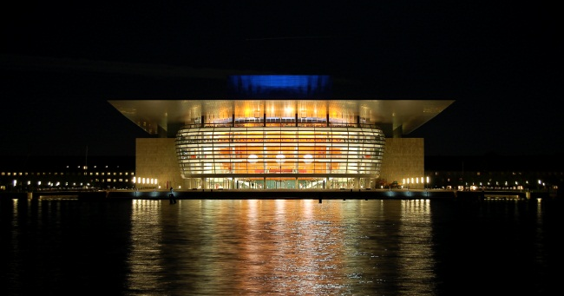
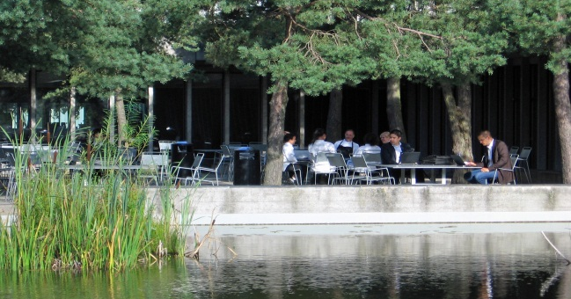
8th European Conference on Modelling Foundations
and Applications
ECMFA 2012
July 2-5, 2012, Technical University of Denmark
Kongens Lyngby
Exciting Invited Speakers
Dedicated industry and research tracks
Many workshops and tutorials
Reasonable prices
Attractive Venue
Easy to reach (close to Copenhagen)
See more at www.imm.dtu.dk/ECMFA-2012/
foto: Colourbox
foto: Colourbox

