Slide 1
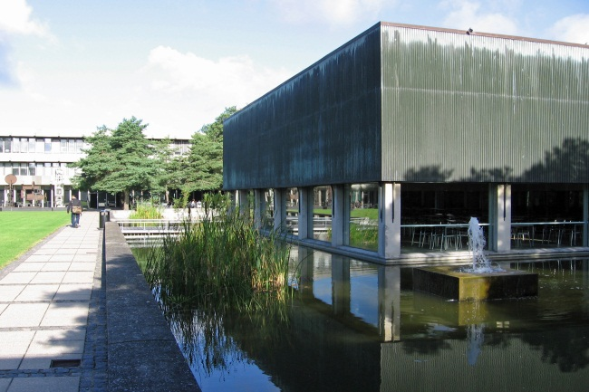
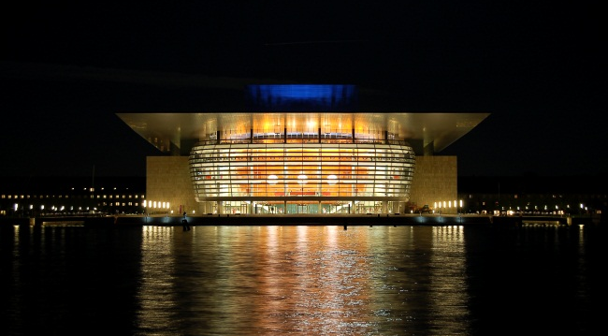
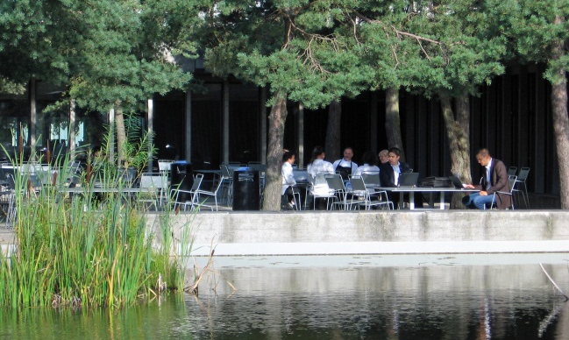
8th European Conference on Modelling Foundations
and Applications
(ECMFA 2012)
Topic
Model Driven Engineering (MDE) is a software development approach based on the use of models for the specification, design, analysis, synthesis, deployment, testing and main-tenance of complex software systems, aimed to produce high quality systems at lower costs. Considering ever in-creasing complexity and cost of development of software, MDE has received considerable attention from industry and academia.
ECMFA is the key European conference aiming at advancement of techniques and furthering underlying knowledge related to Model Driven Engineering. In the past seven years, ECMFA has provided an ideal venue for the interaction among researchers interested in MDE both from the academia and industry. ECMFA 2012 will continue the series of successful events of the last years.
Venue
ECMFA 2012 will be held at the Technical University of Denmark (DTU), which is one of the leading technical universities in northern Europe. DTU is close to Copen-hagen and can be easily reached by public transportation from downtown Copenhagen and the Copenhagen airport.
Copenhagen is a great place to be particularly in the sum-mer, with a lot of historic sites, many cafes, and cultural events all over the place, the world's best restaurant, a lot of water, and many more fun things to do.
foto: Colourbox
foto: Colourbox
Dates
Abstracts
Paper Submission
Satellite Event Proposals
Early Registration
Conference
Contact
ECMFA 2012 c/o Be-te Elsebeth Strøm DTU Informatics Richard Petersens Plads DK-2800 Kgs. Lyngby, Denmark
ecmfa-info@imm.dtu.dk
15.2.2012
22.2.2012
12.12.2011
23.5.2012
2-5.7.2012
www.imm.dtu.dk/ECMFA-2012

Slide 2
Steering Committee
Richard Paige, University of York, United Kingdom Terry Bailey, Vicinay Cadenas SA, Spain Reda Bendraou, University of Pierre & Marie Curie, France Behzad Bordbar, University of Birmingham, UK Philippe Desfray, Objecteering Software, France Sébastien Gérard, CEA LIST, France Arend Rensink, University of Twente, Netherlands Julia Rubin, IBM Research, Israel Andy Schürr, Darmstadt University of Technology, Germany Regis Vogel, University of Michigan, USA
Organisation Committee
General chairs
Ekkart Kindler, DTU Informatics, Denmark Harald Störrle, DTU Informatics, Denmark
Publicity chairs
Richard Paige, York University, United Kingdom Ekkart Kindler, DTU Informatics, Denmark
Publications chair
Dimitris Kolovos, York University, United Kingdom
Programme committee chairs
Juha-Pekka Tolvanen, MetaCase, Finland Antonio Vallecillo, Universidad de Malaga, Spain
Workshops and tutorials chairs
Harald Störrle, DTU Informatics, Denmark Hubert Baumeister, DTU Informatics, Denmark
Tools and posters chair
Julia Rubin, IBM Research, Israel
Program Committee
Foundations track Vasco Amaral, Universidade Nova de Lisboa, Portugal Marco Bambrilla, Politecnico di Milano, Italy Stephen C. Barrett, United International College, Hong Kong, China Reda Bendraou, University of Pierre & Marie Curie, France Xavier Blanc, Université Pierre et Marie Curie, France Behzad Bordbar, University of Birmingham, UK Jordi Cabot, INRIA and Ecole des Mines de Nantes, France Benoit Combemale, University of Rennes, France Zinovy Diskin, McMaster University/University of Waterloo, Canada Gregor Engels, University of Paderborn, Germany Anne Etien, University of Lille and INRIA, France Robert France, Colorado State University, USA Jesus Garcia Molina, Universidad de Murcia, Spain Sebastien Gerard, CEA LIST, France Marie-Pierre Gervais, Univ. of Paris Ouest Nanterre La Défense, France Martin Gogolla, University of Bremen, Germany Pieter van Gorp, University of Eindhoven, The Netherlands Jeff Gray, University of Alabama, US Esther Guerra, Universidad Autonoma de Madrid, Spain Michael R. Hansen, Technical University Denmark, Denmark Reiko Heckel, University of Leicester, UK Gabor Karsai, Vanderbilt University, USA Thomas Kühne, Victoria University of Wellington, Australia Ivan Kurtev, University of Twente, The Netherlands Roberto Lopez-Herrejon, Johannes Kepler, University Linz, Austria Birger Møller-Pedersen, University of Oslo, Norway Alfonso Pierantonio, University of L'Aquila, Italy Ivan Porres, Abo Akademi University, Finland Juan Antonio de la Puente, Universidad Politecnica de Madrid, Spain Arend Rensink, University of Twente, The Netherlands Louis Rose, University of York, UK Bernhard Rumpe, RWTH Aachen, Germany Houari Sahraoui, University of Montreal, Canada Doug Schmidt, Vanderbilt University, USA Andy Schürr, Darmstadt University of Technology, Germany Marten van Sinderen, University of Twente, The Netherlands James Steel, University of Queensland, Australia Ragnhild Van Der Straeten, Vrije Universiteit Brussel, Belgium Gabriele Taentzer, Philipps-Universität Marburg, Germany
Francois Terrier, CEA LIST, France Hans Vangheluwe, University of Antwerp, Belgium
Daniel Varró, Budapest UTE, Hungary Cristina Vicente-Chicote, Universidad Politecnica de Cartagena, Spain Edward D. Willink, Thales Research, UK Manuel Wimmer, TU Vienn, Austria Tao Yue, Simula Research Lab, Norway Gefei Zhang, Arbato Systems, Germany Steffen Zschaler, Kings College London, UK
Applications track
Jan Aagedal, Norse Solutions AS, Norway Terry Bailey, Vicinay Cadenas SA, Spain Michael von der Beeck, BMW Group, Germany Mariano Belaunde, Orange Labs, France Jorn Bettin, Sofismo, Switzerland Tony Clark, Thames Valley University, London, UK Diarmuid Corcoran, Ericsson, Sweden Zhen Ru Dai, Hamburg University of Applied Science (HAW), Germany Stephan Flake, Orga Systems, Germany Mathias Fritzsche, SAP AG, Germany Markus Heller, SAP, Germany
Andreas Hoffmann, Fraunhofer, Germany
Teemu Kanstren, VTT, Finland Jochen Kuester, IBM Research, Switzerland Vinay Kulkarni, Tata Consultancy Services, India Dragan Milicev, University of Belgrade, Serbia Parastoo Mohagheghi, Sintef, Norway Tor Neple, Norse Solutions AS, Norway Olli-Pekka Puolitaival, F-Secure Corporation, Finland Laurent Rioux, THALES, France Tom Ritter, Frauenhofer FOKUS, Germany Julia Rubin, IBM Research, Israel Andrey Sadovykh, SOFTEAM, France Bernhard Schätz, fortiss GmbH, Germany Bran Selic, Malina Software, Canada Renuka Sindghatta, IBM Research, India John Slaby, Raytheon, USA Alin Stefanescu, University of Pitesti, Romania Salvador Trujillo, Ikerlan, Spain Andreas Ulrich, Siemens AG, Germany Markus Voelter, Independent/ itemis, Germany Olaf Zimmermann, IBM Zurich, Switzerland

