Slide 1
System-Level Modeling and Synthesis of Flow-Based Microfluidic Biochips
Wajid Minhass, Paul Pop, Jan Madsen
Technical University of Denmark

Slide 2

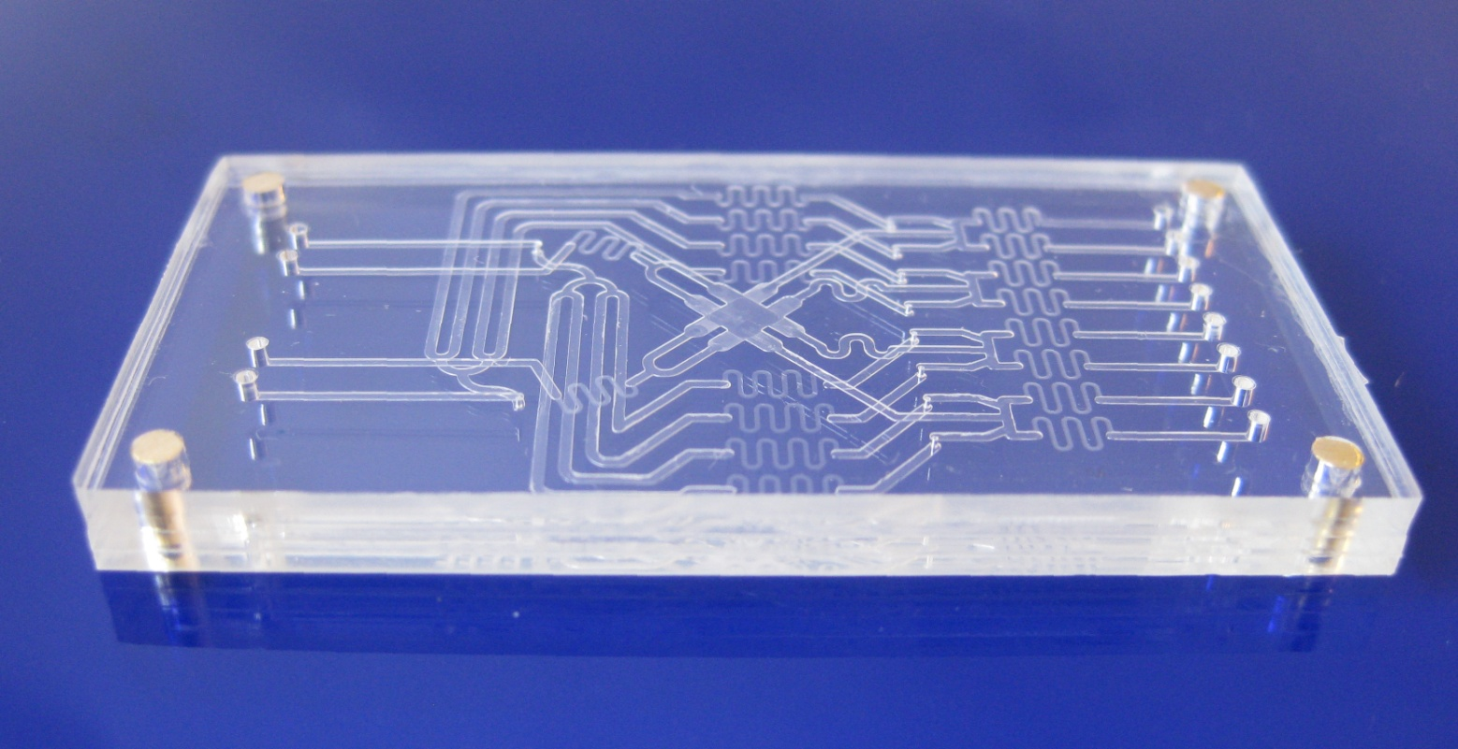
Flow-Based Microfluidic Biochips
Manipulations of continuous liquid through fabricated micro-channels
10 mm
Switches
Waste channels
Inlets
Chamber
Outlets
12/10/2011
System-Level Modeling and Synthesis of Flow-Based Microfluidic Biochips

Slide 3
Outline
  Biochip Architecture
  Challenges and Motivation
  System Model
      Component Model
      Biochip Architecture Model
      Biochemical Application Model
  Biochip Synthesis Tasks
  Problem Formulation
  Proposed Solution
      List Scheduling + Contention Aware Edge Scheduling
  Experimental Evaluation
  Conclusions
12/10/2011
System-Level Modeling and Synthesis of Flow-Based Microfluidic Biochips

Slide 4
Biochip Architecture
Microfluidic Valve – Multi-Layer Soft Lithography
12/10/2011
System-Level Modeling and Synthesis of Flow-Based Microfluidic Biochips

Slide 5
Biochip Architecture
Microfluidic Large Scale Integration (LSI) :
Valves combined to form more complex units
Microfluidic Switch
12/10/2011
System-Level Modeling and Synthesis of Flow-Based Microfluidic Biochips

Slide 6
Biochip Architecture
Microfluidic Mixer
12/10/2011
System-Level Modeling and Synthesis of Flow-Based Microfluidic Biochips

Slide 7
Biochip Architecture
Microfluidic Mixer
12/10/2011
System-Level Modeling and Synthesis of Flow-Based Microfluidic Biochips

Slide 8
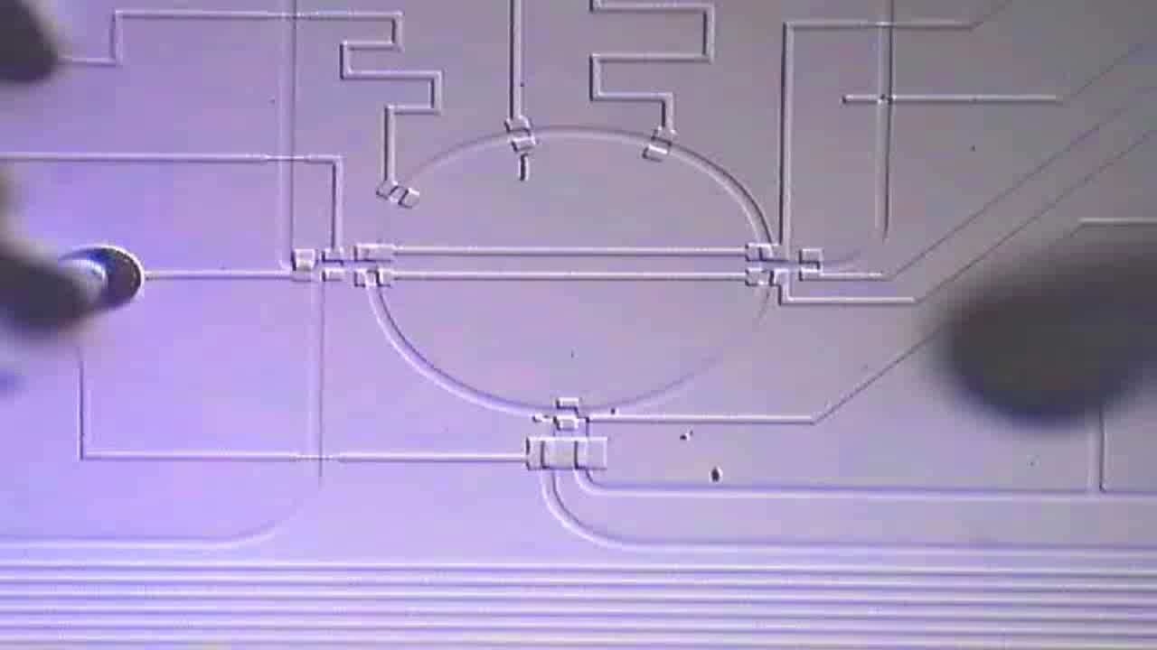
Biochip Architecture
Microfluidic Mixer
http://groups.csail.mit.edu/cag/biostream
12/10/2011
System-Level Modeling and Synthesis of Flow-Based Microfluidic Biochips

Slide 9
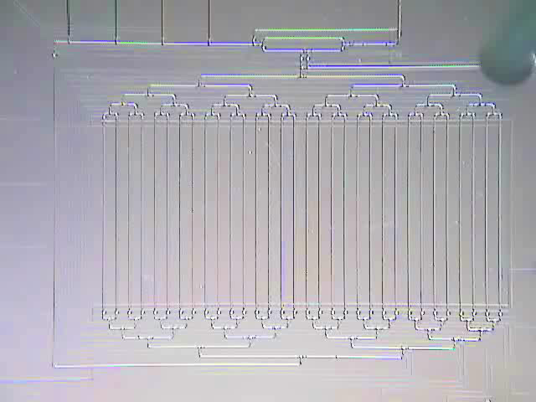
Components
  Mixer
  Detector
  Filter
  Heater
  Separator
  Storage Units
  …
http://groups.csail.mit.edu/cag/biostream
12/10/2011
System-Level Modeling and Synthesis of Flow-Based Microfluidic Biochips

Slide 10
Biochip Architecture
Schematic View
Functional View
12/10/2011
System-Level Modeling and Synthesis of Flow-Based Microfluidic Biochips

Slide 11
Challenges
  Manufacturing technology, soft lithography, advancing faster than Moore’s law
  Increasing design complexity
  Current methodologies
    Full-custom
    Bottom-up
  Radically different, top-down, synthesis and design methodologies required
12/10/2011
System-Level Modeling and Synthesis of Flow-Based Microfluidic Biochips

Slide 12
System Model
  The model considers discretized fluid volumes
  Fluid sample volumes can be precisely controlled (unit sized samples)
  Each sample occupies a certain length on the flow channel using metering
12/10/2011
System-Level Modeling and Synthesis of Flow-Based Microfluidic Biochips

Slide 13
Metering – Unit Sized Samples
Metering is done by transporting the sample between two valves that are a fixed length apart
Input
Waste
Input
Waste
To other components
To other components
open
(a)
(b)
closed
Input
Waste
Input
Waste
To other components
To other components
(c)
(d)
12/10/2011
System-Level Modeling and Synthesis of Flow-Based Microfluidic Biochips
Notes:
Microfluidic metering process. Open and closed symbols refer to open and actuated control valves, respectively. (a) Sample of interest flows
from an input port through one half of the rotary mixer. (b) Sample is compacted against a valve on the right side of the mixer, ensuring a
consistent cross-sectional area. (c) Excess sample is flushed to the waste port. (d) A unit-sized sample results and can be mixed or transported to
storage

Slide 14
Component Model
Microfluidic Mixer
Flow Layer Model:
Operational Phases + Execution Time
Five phases:
Ip1
Ip2
Mix (0.5 s)
Op1
Op2
(1) Ip1
12/10/2011
System-Level Modeling and Synthesis of Flow-Based Microfluidic Biochips

Slide 15
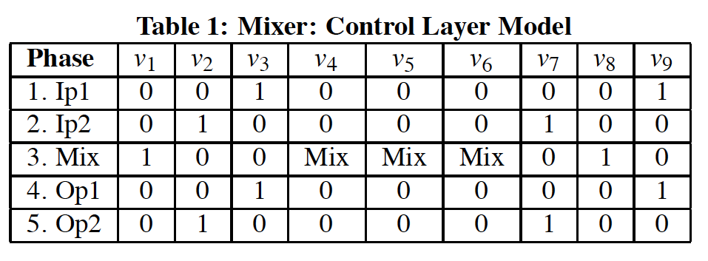
Component Model
Input
Waste
Input
Waste
(2) Ip2
(3) Mix
Input
Waste
Input
Waste
open
(4) Op1
closed
(5) Op2
12/10/2011
System-Level Modeling and Synthesis of Flow-Based Microfluidic Biochips

Slide 16
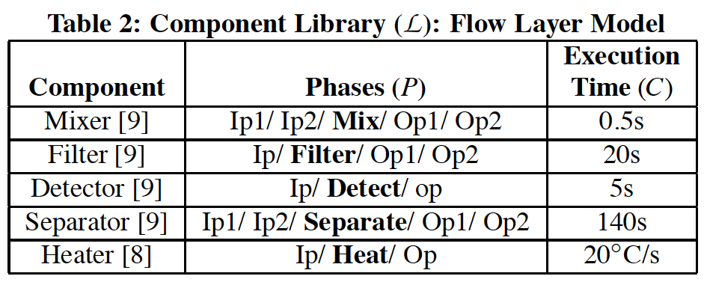
Biochip Architecture Model
12/10/2011
System-Level Modeling and Synthesis of Flow-Based Microfluidic Biochips

Slide 17
Biochip Architecture Model
Topology graph based model
A = (N, S, D, F, c) , where,
N = All nodes (Switches and Components)
S = Switch nodes only, e.g., S₁
D = Directed edge between 2 nodes, D_{In1, S1}
F = Flow path, i.e., set of two or more directed edges
c = Transport latency associated with a flow path or a directed edge
12/10/2011
System-Level Modeling and Synthesis of Flow-Based Microfluidic Biochips

Slide 18
Flow paths in the architecture
Fluid Transport latencies are comparable to operation execution times
Handling fluid transport (communication) is important
Enumerate flow paths in the architecture
F₁
12/10/2011
System-Level Modeling and Synthesis of Flow-Based Microfluidic Biochips

Slide 19
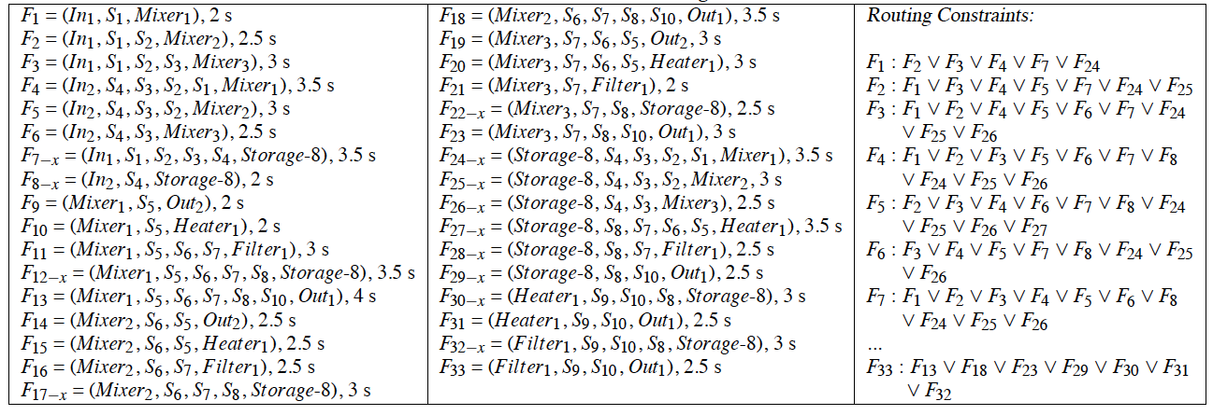
Flow paths in the architecture
A flow path is reserved until completion of the operation, resulting in routing constraints
F₁
F₃
12/10/2011
System-Level Modeling and Synthesis of Flow-Based Microfluidic Biochips

Slide 20
Biochemical Application Model
Directed, acyclic, polar
Each vertex O_{i} represents an operation
Each vertex has an associated weight denoting the execution time
12/10/2011
System-Level Modeling and Synthesis of Flow-Based Microfluidic Biochips

Slide 21
Biochip Synthesis Tasks
Allocation
Placement
Binding
Scheduling
  Operation Scheduling
  Edge Scheduling: Routing latencies comparable to operation execution times
12/10/2011
System-Level Modeling and Synthesis of Flow-Based Microfluidic Biochips

Slide 22
Problem Formulation
Given
  A biochemical application G
  A biochip modeled as a topology graph A
  Characterized component model library L
Produce
  An implementation minimizing the application completion time while satisfying the dependency, resource and routing constraints
  Deciding on:
    Binding of operations and edges
    Scheduling of operations and edges
12/10/2011
System-Level Modeling and Synthesis of Flow-Based Microfluidic Biochips

Slide 23
Proposed Solution
Allocation and Placement: Given
Binding and Scheduling (Operations):
  Greedy Binding + List Scheduling
Fluid Routing (Contention Aware Edge Scheduling)
  Greedy Binding + List Scheduling
12/10/2011
System-Level Modeling and Synthesis of Flow-Based Microfluidic Biochips

Slide 24
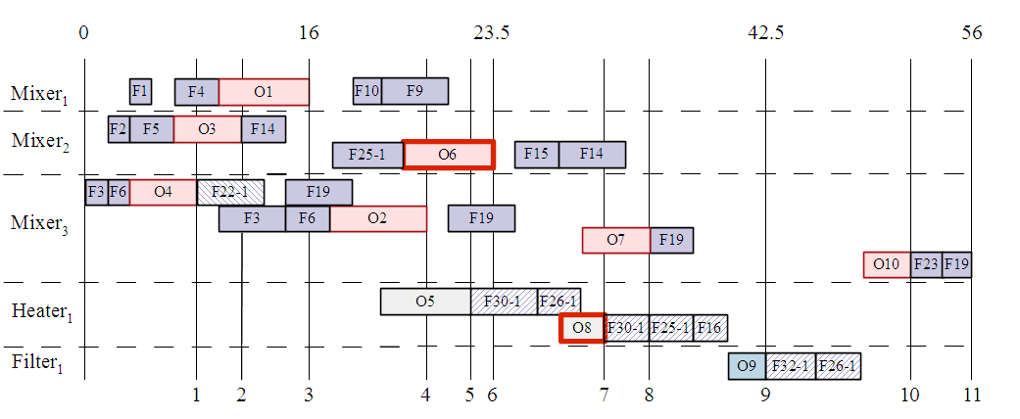
F₁₄
F₁₅
12/10/2011
System-Level Modeling and Synthesis of Flow-Based Microfluidic Biochips

Slide 25
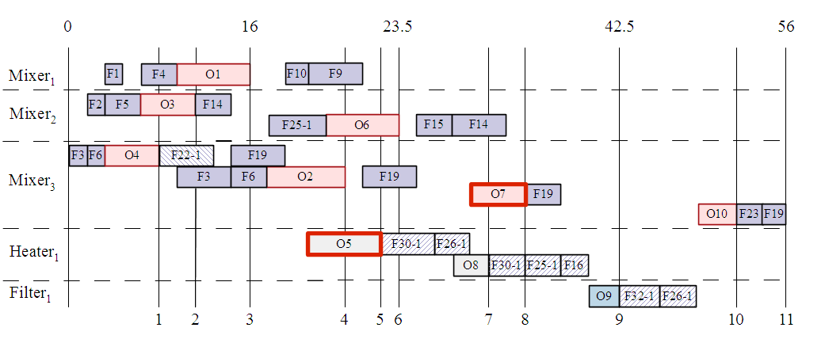
No flow path from Heater1 to Mixer 3!
F₃₀₋₁
F₂₆₋₁
A composite route
12/10/2011
System-Level Modeling and Synthesis of Flow-Based Microfluidic Biochips

Slide 26
Design Methodology
Component Library
Biochemical Application Model
Flow Layer Model
Control Layer Model
Flow Path
Generation
Synthesis
Biochip
Architecture Model
Binding and Scheduling
Routing
Optimization
Graph-based Model
Control Layer Model
Control
Synthesis
Biochip Controller
Design Implementation
12/10/2011
System-Level Modeling and Synthesis of Flow-Based Microfluidic Biochips

Slide 27
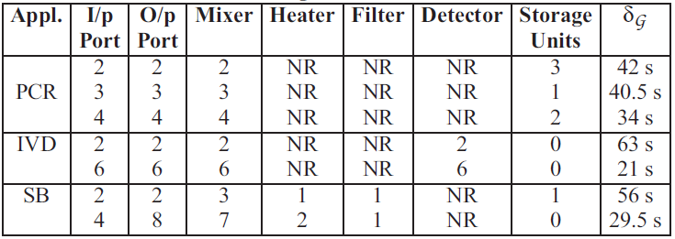
Experimental Results
Synthesizing two Real Life Assays and one Synthetic Benchmark
12/10/2011
System-Level Modeling and Synthesis of Flow-Based Microfluidic Biochips

Slide 28
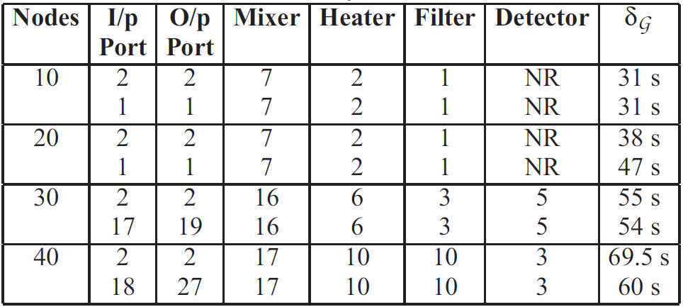
Experimental Results
Varying number of I/O Ports
12/10/2011
System-Level Modeling and Synthesis of Flow-Based Microfluidic Biochips

Slide 29
Conclusions
Proposed
  a component model for the fluidic components
  an architecture model for the flow-based microfluidic biochips
Proposed a system-level modeling and simulation framework for flow-based biochips
  reduced design cycle time
  facilitating programmability and automation
Demonstrated the approach by synthesizing two real life assays and four synthetic benchmark on different biochip architectures
12/10/2011
System-Level Modeling and Synthesis of Flow-Based Microfluidic Biochips

