Slide 1

Droplet-Aware Module-Based Synthesis for Fault-Tolerant Digital Microfluidic Biochips
Elena Maftei, Paul Pop, and Jan Madsen
Technical University of Denmark
DTU Informatics

Slide 2
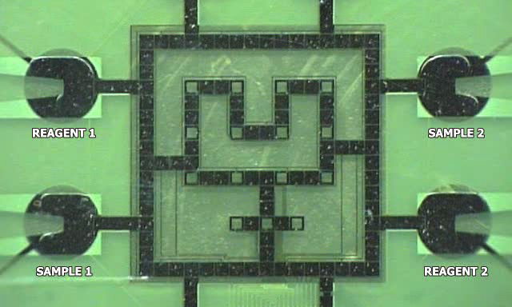
Architecture model
Biochip from Duke University

Slide 3
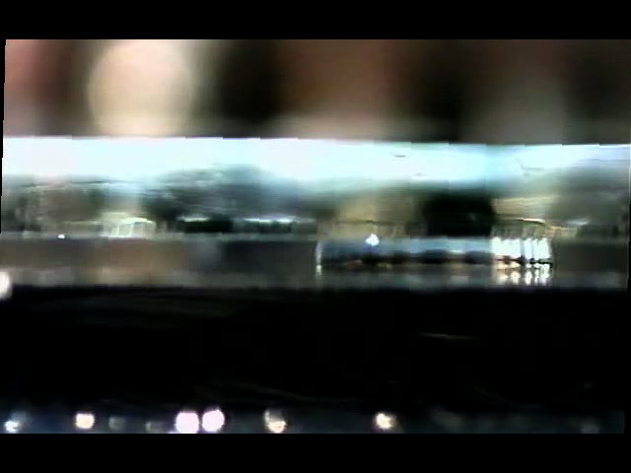
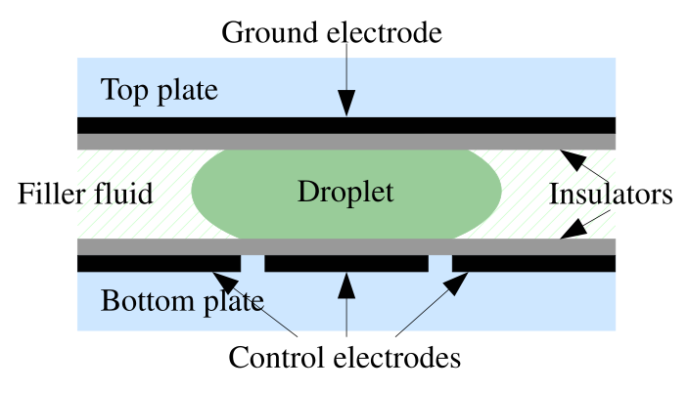
Electrowetting on Dielectric

Slide 4
Reconfigurability
Non-reconfigurable
R₂
Dispensing
Detection
Splitting/Merging
Storage
Mixing/Dilution
B
S₂
Reconfigurable
S₃
R₁
S₁
W

Slide 5
Module-Based Operation Execution
Module: an abstraction—a virtual functional unit
where a reconfigurable operation “executes”
Module library
R₂
Operation | Area (cells) | Time (s)
Mix | 2 x 4 | 3
Mix | 2 x 2 | 4
Dilution | 2 x 4 | 4
Dilution | 2 x 2 | 5
S₂
B
Module
R₃
S₃
Droplets have a fixed movement path inside the module, hence
The position of a droplet
inside a module is ignored
R₁
S₁
W

Slide 6
Droplet-Aware Operation Execution
Droplet-aware: we propose an approach where we keep track of the position of a droplet inside a module
R₂
Droplets can move on any path inside a module, the path is not fixed
For module-based operations we
know the completion time from
the module library.
But now that the droplets can move on any path inside the module area…
  How can we find out the
  operation completion times?
B
S₂
S₃
R₁
S₁
W
2 x 4
module

Slide 7
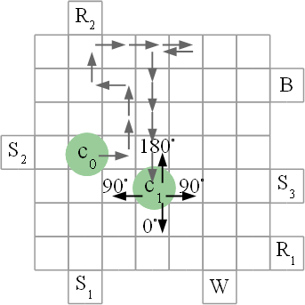




Calculating Operation Completion Time
If the droplet does not move:
very slow mixing by diffusion
If the droplet moves, how long does it take to complete?
We know how long an operation takes on modules
Starting from this, we can decompose the modules and determine the completion percentages:
p⁰, p⁹⁰, p¹⁸⁰

Slide 8
System-Level Design Tasks (Offline!)
Allocation
Binding
Placement & routing
Scheduling

Slide 9
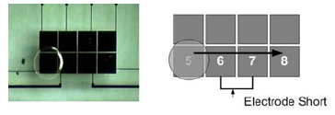
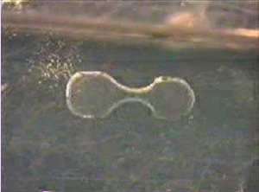
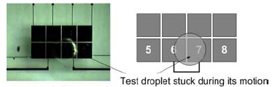
Design Challenges: Faults
Electrode short
Electrode degradation
Imperfect splitting
Hindered transportation

Slide 10

Fault-Tolerant Design
R₂
Faulty cells
Causes
  Dielectric breakdown
  Insulator degradation
  Short between adjacent electrodes
S₂
B
R₃
S₃
R₁
S₁
W
Faulty cells must be avoided during the execution of the operations

Slide 11
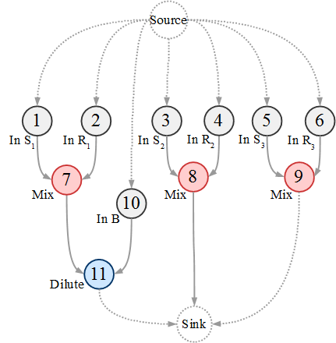
Example
R₂
S₂
B
R₃
S₃
R₁
S₁
W
Application graph

Slide 12
Example
R₂
S₂
B
S₁
R₁
S₂
R₂
S₃
R₃
2 x 3
2 x 3
2 x 3
R₃
S₃
2 x 4
R₁
S₁
W
Application graph

Slide 13

Example (module based)
R₂
S₂
B
S₁
R₁
S₂
R₂
S₃
R₃
2 x 3
2 x 3
2 x 3
R₃
S₃
2 x 4
R₁
S₁
W
t = 2
Application graph

Slide 14

Example (module based)
R₂
S₂
B
S₁
R₁
S₂
R₂
S₃
R₃
2 x 3
2 x 3
2 x 3
R₃
S₃
2 x 4
R₁
S₁
W
t = 2
Application graph

Slide 15
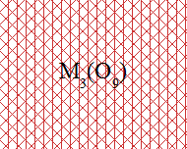
Example (module based)
R₂
S₂
B
S₁
R₁
S₂
R₂
S₃
R₃
2 x 3
2 x 3
2 x 3
R₃
S₃
2 x 4
R₁
S₁
W
t = 8.1
Application graph

Slide 16
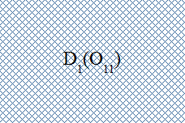
Example (module based)
R₂
S₂
B
S₁
R₁
S₂
R₂
S₃
R₃
2 x 3
2 x 3
2 x 3
R₃
S₃
2 x 4
R₁
S₁
W
t = 8.1
Application graph

Slide 17
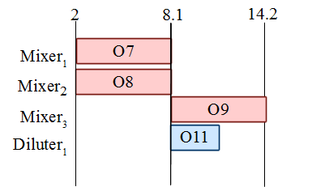
Example (module based: 14.2 s)
S₁
R₁
S₂
R₂
S₃
R₃
2 x 3
2 x 3
2 x 3
2 x 4
Application graph
Schedule

Slide 18
Example (droplet aware)
R₂
S₂
B
S₁
R₁
S₂
R₂
S₃
R₃
2 x 3
2 x 3
2 x 3
R₃
S₃
2 x 4
R₁
S₁
W
t = 2
Application graph

Slide 19
Example (droplet aware)
R₂
S₂
B
S₁
R₁
S₂
R₂
S₃
R₃
2 x 3
2 x 3
2 x 3
R₃
S₃
2 x 4
R₁
S₁
W
t = 2
Application graph

Slide 20
Example (droplet aware)
R₂
S₂
B
S₁
R₁
S₂
R₂
S₃
R₃
2 x 3
2 x 3
2 x 3
R₃
S₃
2 x 4
R₁
S₁
W
t = 2
Application graph

Slide 21
Example (droplet aware)
R₂
S₂
B
S₁
R₁
S₂
R₂
S₃
R₃
2 x 3
2 x 3
2 x 3
R₃
S₃
2 x 4
R₁
S₁
W
t = 4.5
Application graph

Slide 22
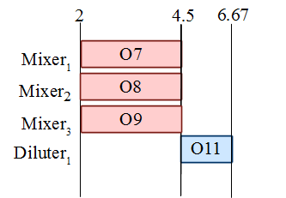
Example (droplet aware: 6.67 s)
S₁
R₁
S₂
R₂
S₃
R₃
2 x 3
2 x 3
2 x 3
2 x 4
Application graph
Schedule

Slide 23
Example
Schedule
Module-based
Schedule
Droplet-aware

Slide 24
Problem Formulation
Input:
  Application graph
  Library of modules
  Area constraint and list of faulty electrodes
Output:
  Implementation which minimizes application execution time
    Allocation of modules from module library
    Binding of modules to operations
    Placement of modules on the array
    Routing of droplets inside modules

Slide 25
Optimization Strategy
Allocation and binding Tabu Search
Schedule List Scheduling
Placement of modules KAMER
  Keep all maximal empty rectangles (Bazargan)
  Free space manager that divides the free space into rectangles
  Search engine that selects the best empty rectangle
Routing of droplets inside modules Greedy

Slide 26
Experimental Evaluation
(Colorimetric Protein Assay)
Average schedule length out of 20 runs for
FT-DAS (droplet-aware) vs. FT-BBS (module-based)
Colorimetric protein assay
Colorimetric protein assay
17.37 % improvement for 12 x 12 with one fault
25.91% improvement for 12 x 12 with two faults
Colorimetric protein assay
Colorimetric protein assay

Slide 27
Conclusions and Message
Researchers have so far used the abstraction of “modules”, ignoring the position of droplets
We take into account the position of droplets, and we have proposed a “droplet-aware” operation execution
  Knowing the position of the droplets, we can make a better use of the biochip area, and we can easily avoid the faulty electrodes
We have proposed an optimization strategy, which combines a
Tabu Search metaheuristic and specialized heuristics for scheduling and placement, and a Greedy-like strategy for droplet movement
Extensive experimental evaluation shows the advantage of considering the position of the droplets
Researchers have adapted methods from microelectronics,
using abstractions such as “modules”; new methods are needed,
which take into account the particularities of these biochips

