Slide 1
Routing Algorithms for Flow-based Microfluidic Very Large Scale Integration Biochips
Martin Simonsen Hørslev-Petersen
&
Thomas Onstrup Risager
Technical University of Denmark

Slide 2
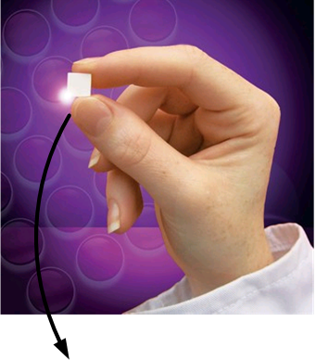
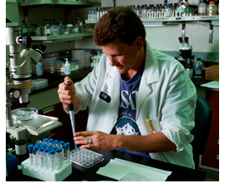
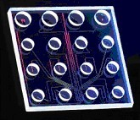
Motivation for biochips
  Applications
  Laboratory work
  Point-of-Care testing
  DNA sequencing

Slide 3

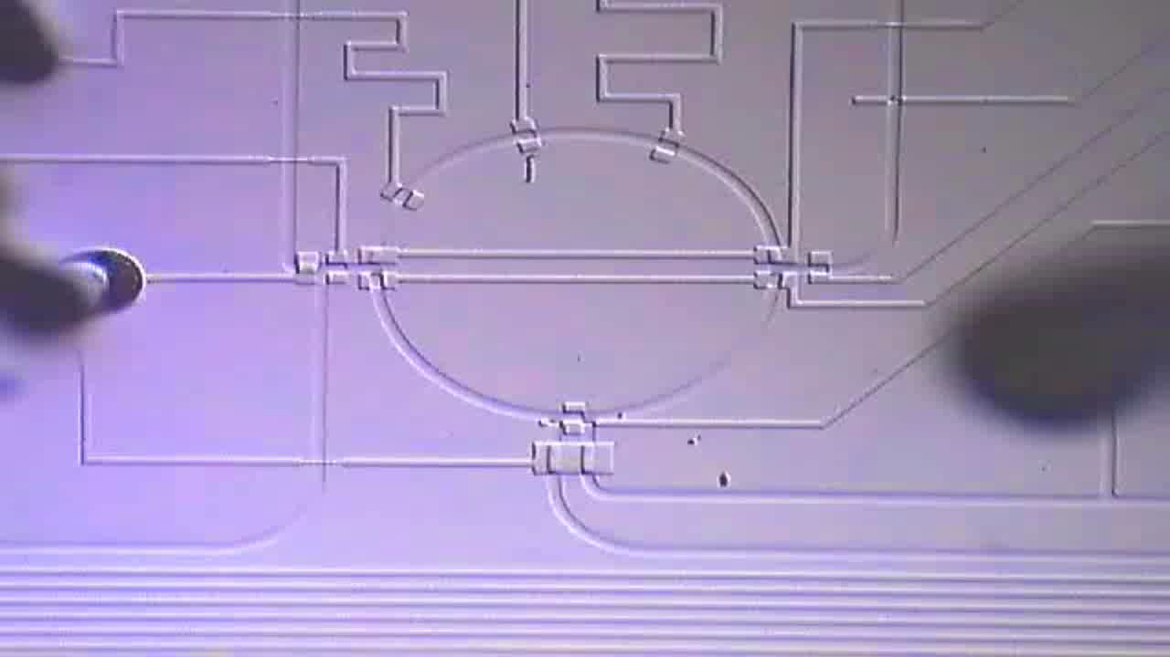
Flow based biochips
Microfluidic biochip
10x real-time
http://groups.csail.mit.edu/cag/biostream

Slide 4
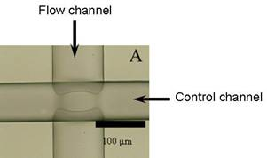
Basic building block: microfluidic valve
Pressure
Source
Control Layer
Valve
v_{a}
Valve
v_{a}
Control Pin z₁
a
Flow Layer
Fluidic Input
Glass Plate
3D View
Top View

Slide 5
Components
Microfluidic switch

Slide 6
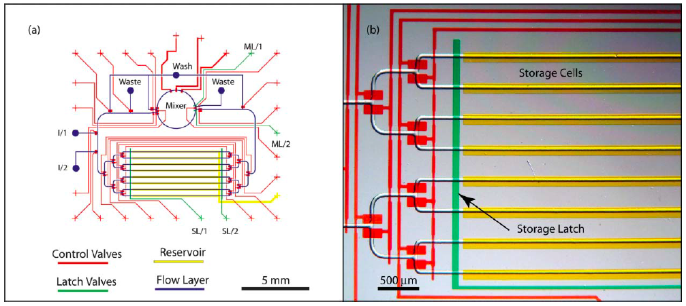
Components
  Mixer
  Filter
  Detector
  Heater
  Storage units
  Separator
[Urbanski et al., Lab-on-a-Chip 2006]

Slide 7
Advantages and challenges
  Advantages
    High throughput (multiple experiments/ chip)
    Reduced cost (reduced sample/ reagent consumption)
    Reduced size (miniaturization)
    Automation
  Challenges
    High design complexity
    Current design methodologies
      Manual: drawing in AutoCAD
      Bottom-up
      Full-custom

Slide 8
Design tasks: VLSI vs mVLSI
VLSI
mVLSI
System Specifications
System Specifications
Architectural Design
Schematic Design
Functional Design
Physical Design
(Flow Layer)
X = (AB + CD)
Y= (A(B+C))
Logic Design
Application Mapping
t1
t2
t3
...
Circuit Design
Control Synthesis
v1
0
1
0
...
v2
1
0
0
...
...
...
...
...
...
Physical Design
Physical Design
(Control Layer)
Fabrication
Fabrication

Slide 9
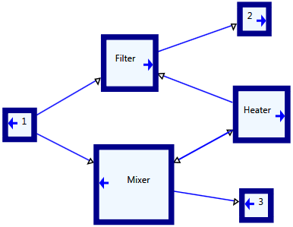
Schematic design
Schematic design
  6 Components
  7 Connections
Remaining Design steps
  Placement
  Flow Routing
  Application Mapping
  Control Synthesis
  Control Routing
  Fabrication

Slide 10
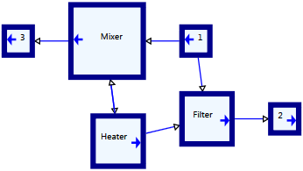
Placement
NP-Complete Problem
Simulated Annealing
  Moving Components.
  Rotation Components.
  Evaluated by cost function.
  Better solutions always preferred.

Slide 11
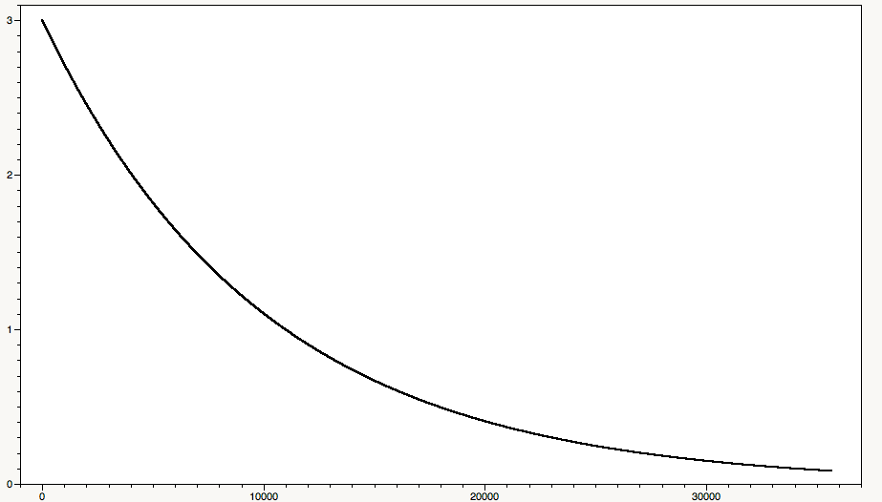
Placement
NP-Complete Problem
Simulated Annealing
  Cooling Schedule.
  Cost Function and Temperature.
  Probability for selecting a worse solution.
  Avoid local minima.

Slide 12
Lee Algorithm
Lee algorithm.
  Wave based algorithm.
  Connecting sets of points

Slide 13
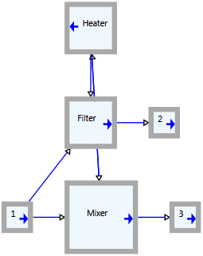
Routing of the flow layer
Lee – Steiner algorithm.
  Find inlet and outlet terminals to connect.

Slide 14
Routing of the flow layer
Lee – Steiner algorithm.
  Wave based algorithm
  From several points to one point.
  Bonus to T-Crosses
  Custom Cost Map.
  Flow wave Break-Through penalty.

Slide 15
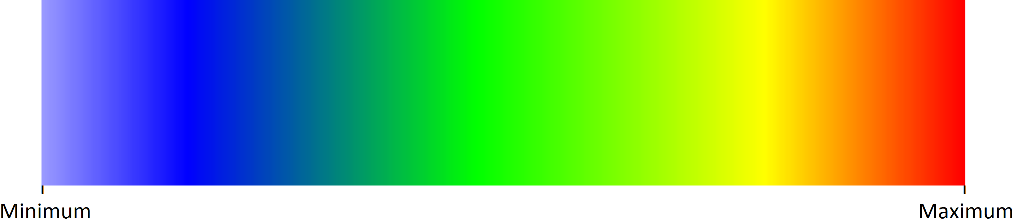
Color Coding
This color coding indicates the distance from the source to the specific cell.

Slide 16
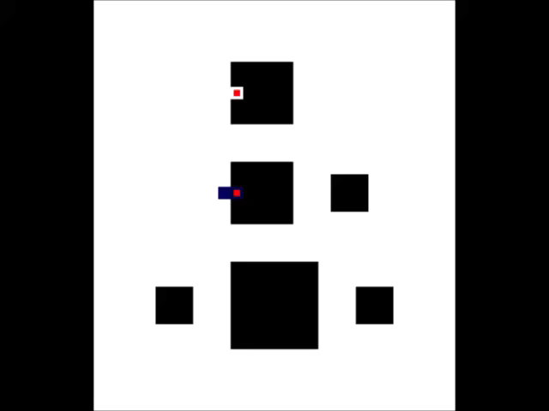
Routing of the flow layer
T-Cross Weight
  1
Detour Weight
  1
Buffer Space
  1

Slide 17
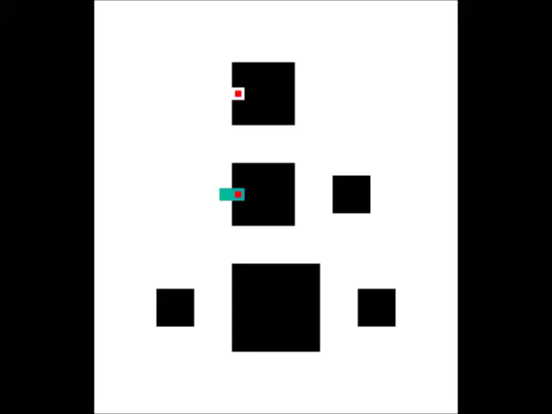
Routing of the flow layer
T-Cross Weight
  15
Detour Weight
  1
Buffer Space
  1

Slide 18
Routing of the flow layer
T-Cross Weight
  1
Detour Weight
  10
Buffer Space
  1

Slide 19

Routing of the flow layer
T-Cross Weight
  1
Detour Weight
  1
Buffer Space
  2

Slide 20
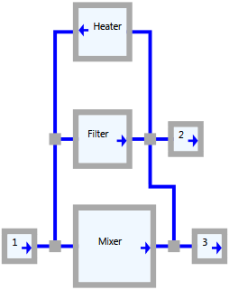
Application mapping and Control Synthesis
Map a biochemical application to the chip.
Generate the execution schedule.
Optimize the control.
  Base case:
  20 valves
  Possible valve sharing

Slide 21
Routing of the control layer
Lee – Steiner
  Route from component to nearest air inlet.
  Rip-up and reroute
    Intelligent rip-up.
    Poisson distributed rip-up
  Port Spacing

Slide 22
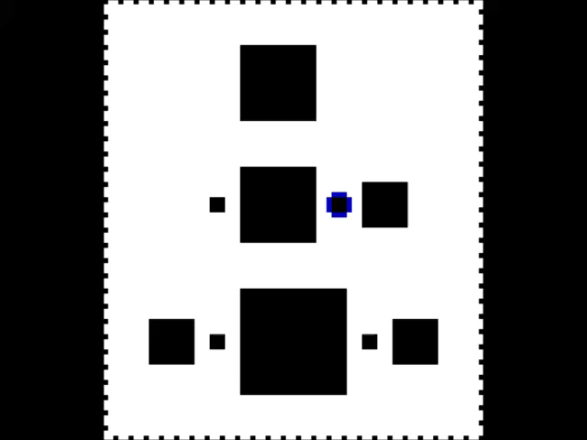
Routing of the control layer
Lee – Steiner
  Route from component to nearest air inlet.
  Rip-up and reroute
    Intelligent rip-up.
    Poisson distributed rip-up
  Port Spacing

Slide 23
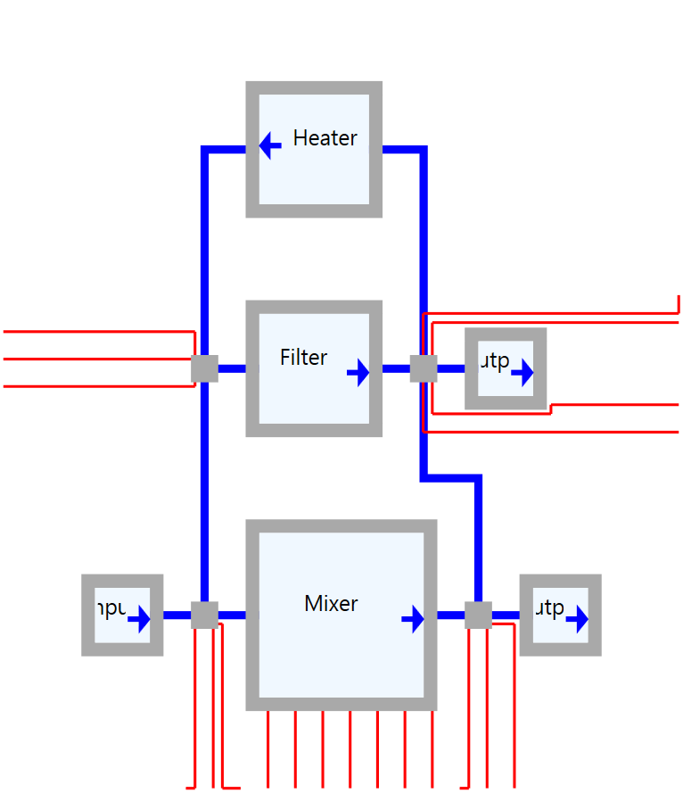
Routing of the control layer
Lee – Steiner
  Route from component to nearest air inlet.
  Rip-up and reroute
    Intelligent rip-up.
    Poisson distributed rip-up
  Port Spacing

Slide 24
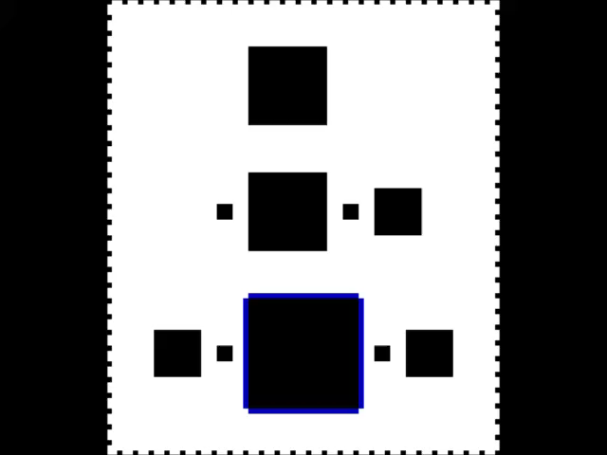
Routing of the control layer
Lee – Steiner
  If Control line sharing :
    Routing between components first.
  The 4 switches share one control line
  The filter and mixer shares one control line.

Slide 25
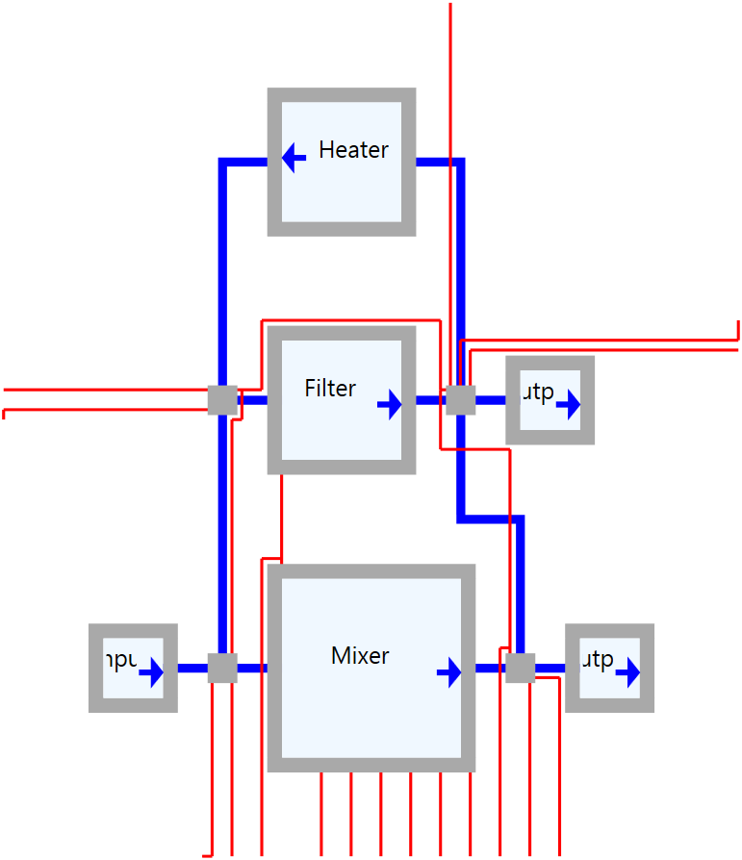
Routing of the control layer
Lee – Steiner
  If Control line sharing:
    Routing between components first.
  The 4 switches share one control line
  The filter and mixer shares one control line.

Slide 26
Routing of the control layer
Lee – Steiner
  If Control line sharing :
    Routing between components first.
  The 4 switches share one control line
  The filter, heater, and mixer shares one control line.

Slide 27
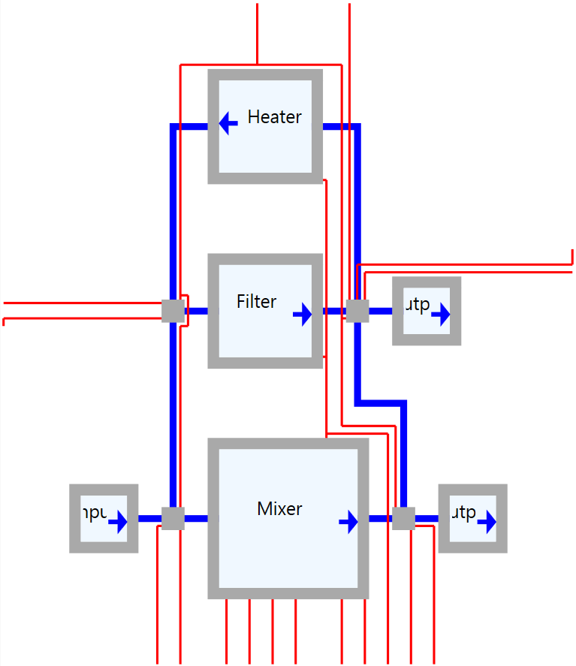
Routing of the control layer
Lee – Steiner
  If Control line sharing :
    Routing between components first.
  The 4 switches share one control line
  The filter, heater, and mixer shares one control line.

