Slide 1


Tabu Search-Based Synthesis of Dynamically Reconfigurable Digital Microfluidic Biochips
Elena Maftei, Paul Pop, Jan Madsen
Technical University of Denmark
DTU Informatics
www.dreamstime.com
Notes:
Leave the droplet picture
Hello everybody, and thank for your introduction.
The paper I am presenting is about the design optimization of multi-cluster systems implementing hard-real time applications.
<click>
What is a multi-cluster?

Slide 2
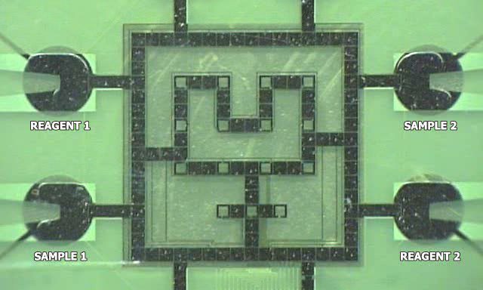
Digital Microfluidic Biochip
Biochip created at Duke University

Slide 3
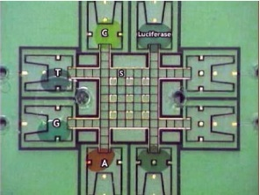
Microfluidic Biochips
Applications
  Sampling and real time testing of air/water for biochemical toxins
  Detection of adverse atmospheric conditions
  DNA analysis and sequencing
  Clinical diagnosis
  Point of care devices
Types:
  Continuous flow microfluidic biochips
  Digital microfluidic biochips
Notes:
Ok

Slide 4
Microfluidic Biochips
Advantages:
  High throughput (reduced sample / reagent consumption)‏
  Space (miniaturization)‏
  Time (parallelism)‏
  Automation (minimal human intervention)‏
Challenges:
  Design complexity
  Radically different design and test methods required
Notes:
Ok

Slide 5
Outline
Motivation
Architecture
Typical Design Tasks
Problem Formulation
Proposed Solution
  Tabu Search-Based Synthesis
  Dynamic Placement Algorithm
Experimental Evaluation
Conclusions

Slide 6
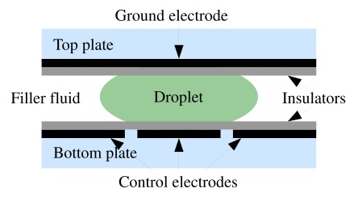
Architecture and Working Principles
Biochip architecture Cell architecture
Electrowetting-on-dielectric
Operations:
  Dispensing
  Transport
  Mixing
  Splitting
  Storage

Slide 7
Architecture and Working Principles
Biochip architecture Cell architecture
Electrowetting-on-dielectric
Operations:
  Dispensing
  Transport
  Mixing
  Splitting
  Storage

Slide 8
Architecture and Working Principles
Biochip architecture Cell architecture
Electrowetting-on-dielectric
Operations:
  Dispensing
  Transport
  Mixing
  Splitting
  Storage

Slide 9
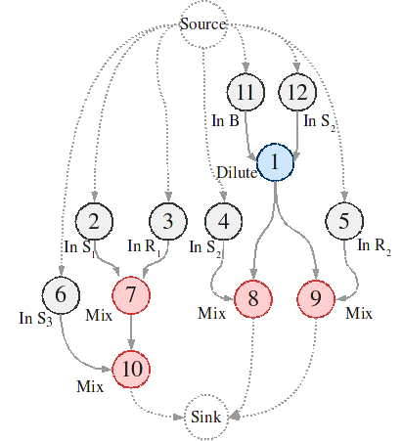
Design Tasks
Operation
Area(cells)‏
Time(s)‏
10
5
8
3
Mixing
Mixing
Dilution
Dilution
2x2
1x3
1x3
2x5
Notes:
Make only one slide out of this | make a proper table | animation with all coming one by one...

Slide 10
Design Tasks
Allocation
Operation
Area(cells)‏
Time(s)‏
10
5
8
3
Mixing
Mixing
Dilution
Dilution
2x2
1x3
1x3
2x5
Notes:
Make only one slide out of this | make a proper table | animation with all coming one by one...

Slide 11
Design Tasks
Allocation
Operation
Area(cells)‏
Time(s)‏
10
5
8
3
Mixing
Mixing
Dilution
Dilution
2x2
1x3
1x3
2x5
Binding & Scheduling
Notes:
Make only one slide out of this | make a proper table | animation with all coming one by one...

Slide 12
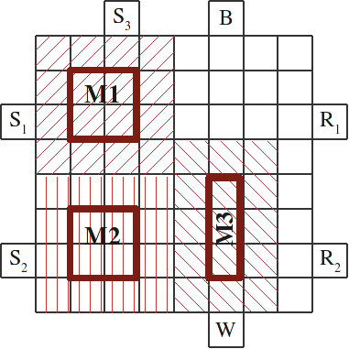
Design Tasks
Allocation
Operation
Area(cells)‏
Time(s)‏
10
5
8
3
Mixing
Mixing
Dilution
Dilution
2x2
1x3
1x3
2x5
Binding & Scheduling
Placement & Routing
Notes:
Make only one slide out of this | make a proper table | animation with all coming one by one...

Slide 13
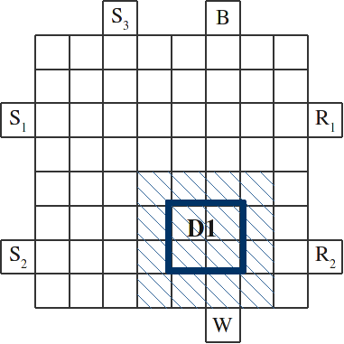
Reconfigurability

Slide 18
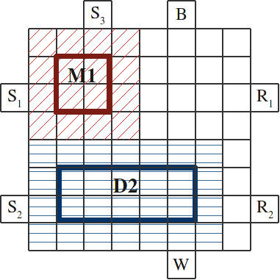
Reconfigurability

Slide 20
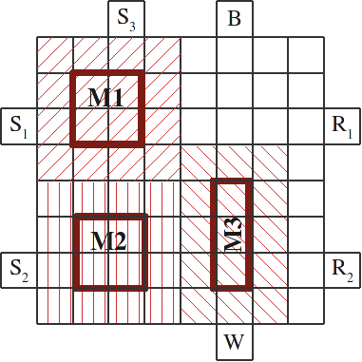
Reconfigurability

Slide 22
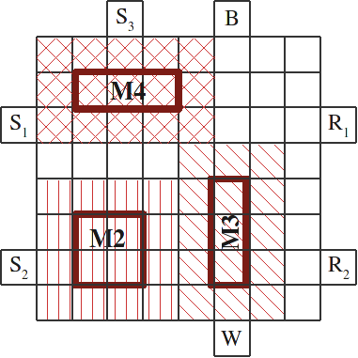
Reconfigurability

Slide 23
Reconfigurability

Slide 24
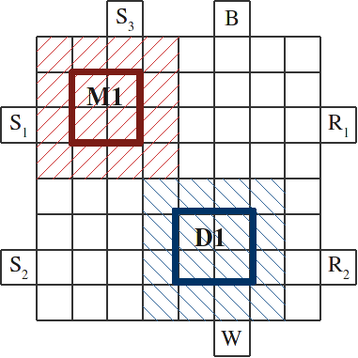
Reconfigurability

Slide 25
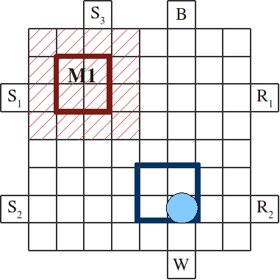
Reconfigurability

Slide 26
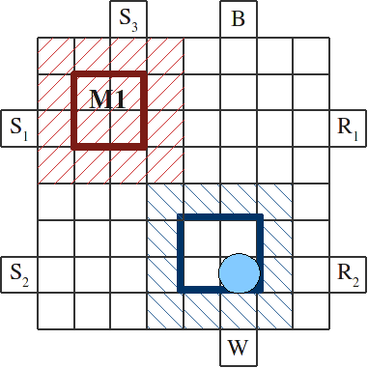
Reconfigurability

Slide 27
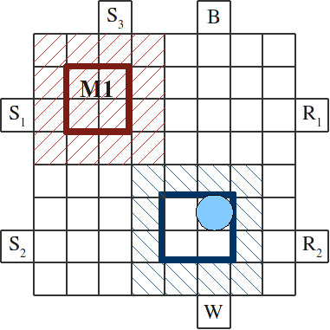
Reconfigurability

Slide 28
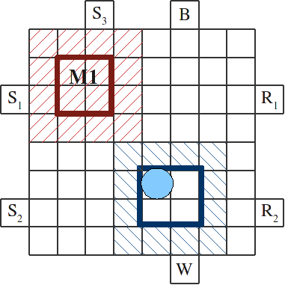
Reconfigurability

Slide 29
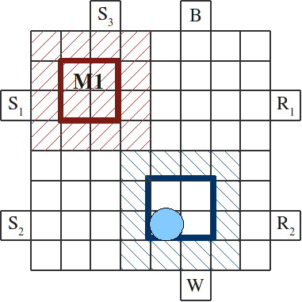
Reconfigurability

Slide 30
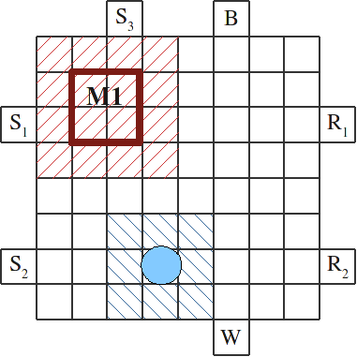
Reconfigurability

Slide 31
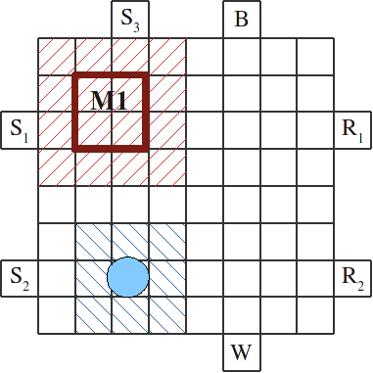
Reconfigurability

Slide 32
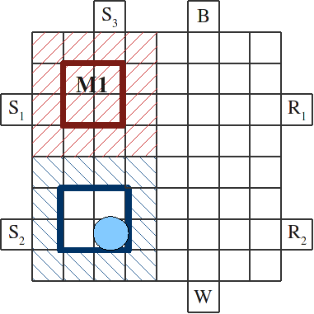
Reconfigurability

Slide 33
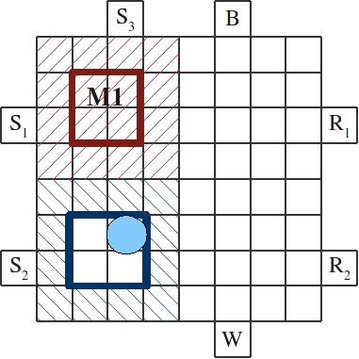
Reconfigurability

Slide 34
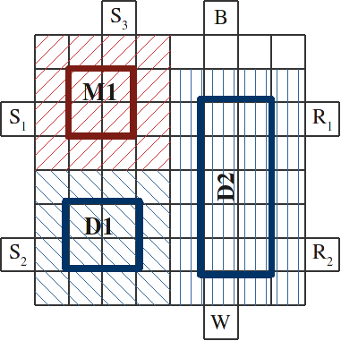
Reconfigurability

Slide 35
Reconfigurability
Constraint on the overhead brought by droplet routing.

Slide 36
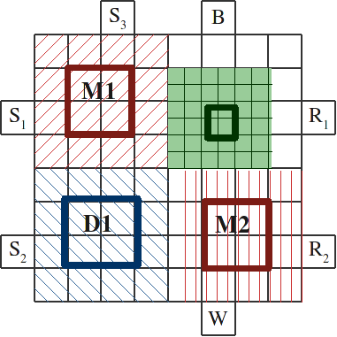
Reconfigurability

Slide 37
Reconfigurability

Slide 38
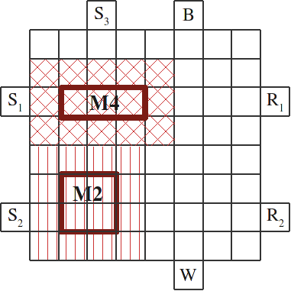
Reconfigurability

Slide 39
Reconfigurability
Without dynamic reconfiguration: t+18

Slide 40
Problem Formulation
Input
  Sequencing graph
  Library of modules
  Area constraint
Output
  Implementation which minimizes application execution time
    Allocation of modules from modules library
    Binding of modules to operations in sequencing graph
    Scheduling of operations
    Placement of modules on the array

Slide 41
Related Work
F. Su and K. Chakrabarty. 2005. Unified high-level synthesis and module placement for defect-tolerant microfluidic biochips. In Proceedings of Design Automation Conference. 825-830.
P.-H. Yuh, C.-L. Yang and Y.-W. Chang. 2007. Placement of defect-tolerant digital microfluidic biochips using the T-tree formulation. ACM Journal on Emerging Technologies in Computing Systems 3(3).

Slide 42
Related Work
F. Su and K. Chakrabarty. 2005. Unified high-level synthesis and module placement for defect-tolerant microfluidic biochips. In Proceedings of Design Automation Conference. 825-830.
P.-H. Yuh, C.-L. Yang and Y.-W. Chang. 2007. Placement of defect-tolerant digital microfluidic biochips using the T-tree formulation. ACM Journal on Emerging Technologies in Computing Systems 3(3).
These works consider fixed modules for all operations.

Slide 43
Optimisation Strategy
Design Optimisation:
  Allocation of modules from the library
  Binding of modules to operations
  Priorities of operations
  Schedule of the operations
    Placement of modules is performed inside scheduling
  Placement of the modules
    Algorithm proposed for DR-FPGAs
      Free space manager that divides the free space into rectangles
      Search engine that selects the best empty rectangle
      We have modified MER in order to minimise the fragmentation of free space on the chip
Tabu Search
List Scheduling
MER (Maximal Empty Rectangles)

Slide 45
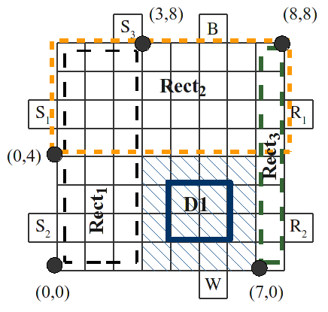
Dynamic Placement Algorithm

Slide 46
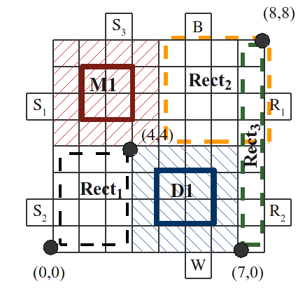
Dynamic Placement Algorithm

Slide 47
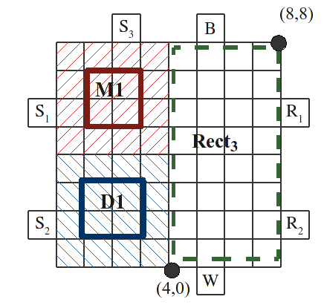
Dynamic Placement Algorithm

Slide 48
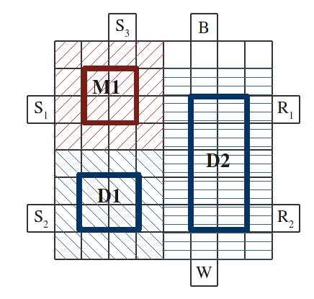
Dynamic Placement Algorithm

Slide 49
Experimental Evaluation
TS Algorithm implemented in Java
3 set of tests
  Quality of the proposed algorithm
    Comparison with an Integer Linear Programming (ILP) approach
  Improvement brought by dynamic reconfiguration
    Comparison between complete TS algorithm and the same algorithm without considering dynamic reconfiguration
  Comparison with the approach proposed by Yuh et al.

Slide 50
Experimental Results
Quality of the solution: comparison with an ILP Implementation
PCR
In Vitro Diagnosis

Slide 51
Experimental Results
Improvement brought by dynamic reconfiguration in schedule length
60min
Colorimetric protein assay
10min
1min

Slide 52
Experimental Results
Comparison with Yuh et al.
Colorimetric protein assay

Slide 53
Conclusions
Addressed design problems characteristic to digital microfluidic biochips.
Proposed a Tabu Search-based method for the unified allocation, binding, scheduling and dynamic placement.
Shown that by taking advantage of the reconfigurability of digital microfluidic biochips during the execution of operations leads to improvements.

Slide 54

…and answers

