Slide 1
Tradeoff Analysis for Dependable Real-Time Embedded Systems during the Early Design Phases
Junhe Gan
Notes:
I am glad to present my PhD work: Tradeoff Analysis for Dependable Real-Time Embedded Systems during the Early Design Phases.

Slide 2






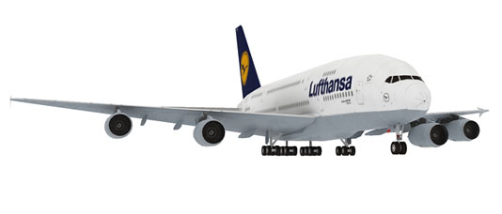

Introduction: embedded systems
General Purpose Computer Systems
Embedded Systems
Notes:
Most of the High-tech products we use today are controlled by digital computer systems. When talking about digital computers, we may immediately think of the general purpose computer systems, such as laptops, desktops and Ipads. However, the computers inside most of the devices we used are a special type of computer systems, called embedded systems. Over 98% of the microprocessors produced are used in embedded systems.
Compared to the general purpose computer systems, embedded systems are usually used in a specialized application domain, performing a specific set of functions, repeatedly. Embedded systems are everywhere. Mobile phones, digital cameras, cars are examples of embedded systems. They can be large, such as airplanes. They can be very small, such as hearing aids.
Another characteristic of embedded systems is that they are tightly constrained. That is, they have requirements such as high performance, low energy consumption, low cost, small size and short time-to-market.
Most of embedded systems should perform the functions in real-time, with high predictability. Real-time embedded systems can have two types of timing requirements: hard and soft. In hard real-time embedded systems, each task must be completed before its deadline. Otherwise it may lead to catastrophic results.
My thesis work targets on safety-critical and mixed-criticality real-time systems. A safety-critical system is a system whose failure might endanger human life or the environment.

Slide 3
Introduction: design metrics
Unit cost: the monetary cost of manufacturing each copy of the system, excluding NRE cost
NRE cost (Non-Recurring Engineering cost): The one-time monetary cost of designing the system
Performance: the execution time or throughput of the system
Predictability: the key property of any real-time system that the timing requirements must be met.
Power: the amount of power consumed by the system
Robustness: the ability of a system to resist change without altering its implementation
Flexibility: the ability to change the functionality of the system without incurring heavy NRE cost
Dependability (reliability, safety, security, maintainability, and availability)
Challenge: simultaneously optimize competing design metrics
Notes:
As mentioned, embedded systems have very tight constraints on the requirements that they have to fulfill. Those requirements are divided into functional requirements and non-functional requirements. Typical non-functional requirements can be expressed in terms of design metrics, such as, energy consumption, cost, performance, predictability, robustness, flexibility, and dependability attributes. There are general definition of the common design metrics, such as…
It is challenging to design embedded systems with complex functionality and simultaneously optimize multiple design metrics, especially when the design metrics compete with one another. Approaches used for improving a certain design metric can worsen another one. Tradeoffs must be analyzed in order to determine the best solutions that meet such an optimization challenge. We will present more details how we model these design metrics and how we simultaneously optimize them later, in the three papers.

Slide 4
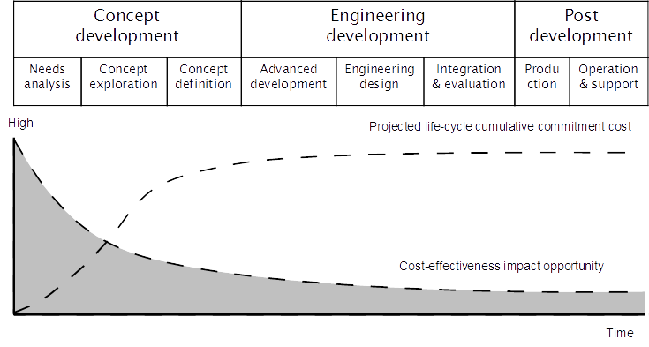
Introduction: early design stages
Early design decisions have a high impact
  More effort should be spent during the early design phases
Challenge: uncertainties
Notes:
There are many life cycle models used in the industry. In principle they all have the following main stages: concept development, engineering development and post-development. We can see from the top part of figure: during concept development, system engineers perform a needs analysis, do concept exploration and definition. Engineering development consists of advanced development, engineering design, integration and evaluation. Then, in post-development, the mass-production from the prototype starts, followed by the operation and maintenance of the system. Of course, these stages may overlap and they are not linear.
Experience from completed system design and development projects has indicated that, the cost spent for the concept development stage accounts for about 20% of the total cost. However, 80% of the cumulative cost of the system is committed already in this stage. Decisions made in the early design stages not only have a high impact on the subsequent implementation choices, but also have substantially negative impacts on the total cost of the system. The bottom part figure shows the projected committed cumulative cost, and the impact opportunity of a design decision over time. The conclusion is that we should spent more effort on the early decisions, in order to increase the chance of completing the projects on time and successfully.
There is a lot of research on embedded systems design, but very few researchers have addressed the early design stages. The challenge is that early design stages are characterized by many uncertainties.

Slide 5
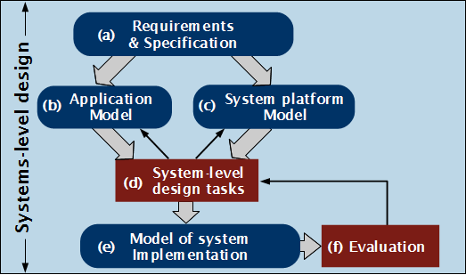
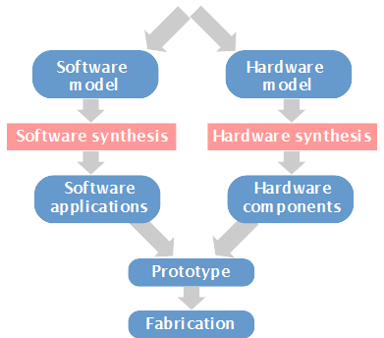
Introduction: system-level design
DSE
Notes:
The aim of any design methodology is to minimize the time-to-market, and coordinate the design tasks such that design metrics are simultaneously optimized. In the embedded systems area, the design methodology is typically organized as in the figure.
Starting from the application model and the architecture model, designers perform system-level design tasks. Based on the design decisions, we build a model of the system implementation, which we can evaluate the design decision to see if it meets the design objectives, such as cost, performance, energy consumptions. If we are not satisfied with the design objectives, we could go back and revisit some of the decisions, we could change the architecture, the mapping, and so on. Once we are satisfied, we synthesis the final implementation. My thesis work includes the steps which are inside the blue box. The low-level development, i.e., a full synthesis of the design solution, whose steps are under the blue box of figure, is outside the scope of my thesis work.
Design space exploration (DSE) is the process of visiting and analyzing the design alternatives to identify good quality solutions. The search in design space is presented in the three arrows which repeatedly visits new design alternatives in (b), (c) and (d) in the figure. DSE can be done manually, which is often the case in practice, but this is very inefficient for designing complex systems. In my thesis, we do automatic DSE supported by tools, and the search is implemented using optimization algorithms in order to determine the good quality solutions in a reasonable time.

Slide 6




Introduction: system models
Scheduling
  Tasks are scheduled by fixed-priority preemptive scheduling, while messages are transmitted using a fixed-priority nonpreemptive policy.
  We use response time analysis to calculate the worst-case response time r_{i} for each task, which is compared to its deadline D_{i} .
  We use the degree of schedulability r_{S} to measure which design alternative is “more schedulable”.
Architecture
Application
WCETs
Notes:
In my thesis, I model the architecture at system level, which is viewed as a set of heterogeneous processing elements interconnected by a shared communication channel. We consider two cases for determining the architecture. One is given a fixed system platform that no modification is allowed. Another is considering a system platform that can be parametrized, e.g., the number of components, the type of components, and the performance of components.
In this thesis I used the task graph model of computation. A task is defined as a sequence of instructions, and it is ready to be executed at any time after its release time. In real-time systems, to be able to provide guarantees, engineers use the Worst-Case Execution Time (WCET). The WCET is an analytical bound on the execution time of a task and can be determined using tools, when the implementation of /tau_i and the details of the archtiecture are given. The figure show a real-time task model.

Slide 7


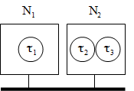

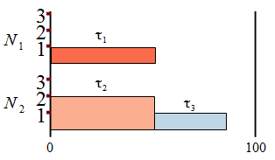
Introduction: system-level design tasks
Function-to-task allocation
Deciding how to decompose functional blocks into tasks
Architecture
selection
Determining the number, the type of conponents of the system platform
Mapping
Deciding in which PE to place a task
Voltage scaling
Assigning the operating mode to execute the task
Scheduling
Deciding the execution order of the mapped tasks on the PE
Notes:
In our thesis work, we have considered the listed system-level design tasks.

Slide 8
Outline
Introduction
Design for Robustness and Flexibility of Real-Time Distributed Applications during the Early Design Phases
Reliability-Aware Dynamic Energy Management for Fault-Tolerant Distributed Embedded Systems
Criticality-Aware Functionality Allocation for Distributed Real-Time Embedded Systems
Summary and contributions
Notes:
Now, let us start talking the first project ” Design for Robustness and Flexibility of Real-Time Distributed Applications during the Early Design Phases”

Slide 9
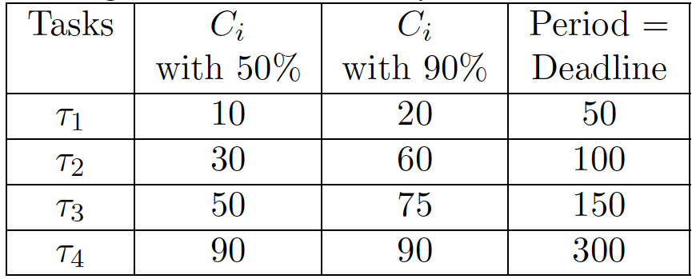
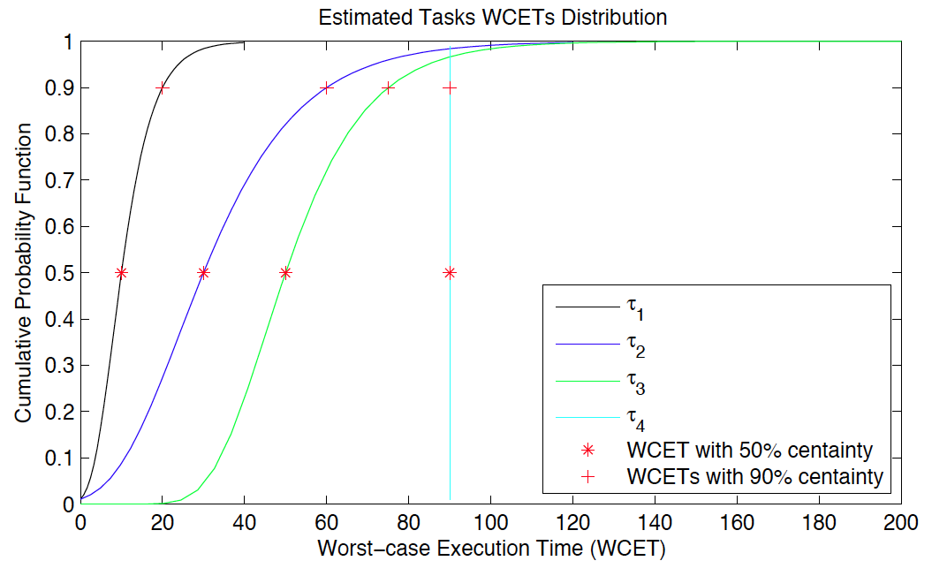
WCET modelling: uncertainties
Details of the PE not fully known
Full implementation not yet available
Hard real-time applications
PE
τ_{i}
Knowing the 50th and 90th percentiles, we can determine the cumulative distribution function of the WCET c_{i}
“Percentile method”
  50th percentile: 30 ms
  90th percentile: 60 ms
The uncertainty in the worst-case execution time (WCET) c_{i} is due to lack of information
Jakob Axelsson. A method for evaluating uncertainties in the early development phases of embedded real-time systems. In Embedded and Real-Time Computing Systems and Applications, 2005.
Notes:
Uncertainty refers to the inability to determine precisely the state or attributes of a system. It can be caused by incomplete knowledge or by stochastic variability. Uncertainties in the early design stages need to be quantified, such that risks of different design alternatives can be estimated for making early design decisions.
Firstly we’ll take a look at uncertainties in the worst-case execution time and functionality requirements. We model our hard real-time application as a set of tasks. Let’s say we have a task /tau_i on a processing element. We all know that the execution time e_i of a task /tau_i varies because of many reasons, for example, the variations in the input data of tasks or the speculative features of modern process.
In our project we are not interested in the variabiltiy of the execution time e_i of a task /tau_i, but in modeling the uncertainties of the wcet c_i of a task /tau_i. Note that the uncertainty in the wcet c_i is due to a lack of information in the early design phases: For example, maybe we don’t yet decided the inplmentation of /tau_i, or maybe we haven’t yet decided the full details of the architecture.
Faced with a lack of information, engineer will use the ”percentile method” to capture the uncertainty. Here we have an application with four tasks, /tau_1 to /tau_4. We assume that the designer will tell us: for each task /tau_i, the wcet with 50% and 90% certainty. The designer have to capture these two values for each processing element where the task could potentially be mapped to. The more information we have the smaller the differece between these two values. For example, for task /tau_4, the 50th and 90th percentiles are equal, this could be a legacy tasks on a Pe for which we have all the details.
For the purposes of our optimiation strategy, we determine the cumulative distribution function of wcet c_i based on the 50th and 90th percentiles of each task /tau_i. In the example, we have two values, 30 ms and 60 ms for task /tau_i. That means that in 50% of the possible future implementations, the task will have a wcet smaller or equal to 30 ms, while in 90% of the cases the value will not exceed 60 ms.

Slide 10

Functionality modeling: uncertainties
Changes in requirements
New version of a product
Evolution of a product line
We capture the functionality
as a set of tasks, baseline S₀
We capture the changes in functionality as scenarios
S₁ is a functionality update, replaces τ₁ with τ₅
S₂ adds τ₆ to
increase performance
S₃ adds a new application,
with tasks τ₇ and τ₈
S₄ is a combination of
S₁ and S₂
I. Bate and P. Emberson. Incorporating scenarios and heuristics to improve flexibility in real-time embedded systems. In Real-Time and Embedded Technology and Applications Symposium, 2006.
Notes:
In the early design phases, there are a lot of uncertainties about the functionality requirements of the application. The reality is that the functionality requirements change during the later design phases. They are not fixed and not fully known in the beggining.
Often we have information about the kinds of changes: for examples, we know what new functions and upgrades we want in a future version of a product. Then, in some industies, you talk about product lines, where you know in advance what features you will intruduce and when, although maybe we don’t know all the details.
We capture the changes in functionality as scenarios. There is a lot of work in the liternature which disigners how these scenarios can be determined. Let us consider the example in the table, which includes one baseline functionality S0 (tasks t1 to t4 from the previous Table), and four future scenarios S1 to S4. S1 replaces /tau_1 with /taul_5 due to a functionality update. S2 introduces t6 for enhancing the application performance. In S3, a new application is added, which is modeled by /tau_7 and /tau_8. S4 is the combination of S1 and S2, which captures the case when both S1 and S2 happen at the same time. Next to each scenario Si, we also specify its weight wi, which indicates the likelihood of this scenario actually happing in the future.

Slide 11
Problem formulation
Given
  Architecture model
  Baseline functionality S₀
  Set of future scenarios S_{i}
Determine
  Mapping M₀ of the tasks in S₀ such that
  the robustness and flexibility of M₀ are maximized
    Robustness the tasks in S₀ have a high chance to be schedulable
    Flexibility M₀ has a high chance to successfully accommodate S_{i}
Notes
  This problem is especially relevant for system integrators
  Changing the mapping is costly, especially in areas such as safety-critical
Notes:
We have the problem formulation as follows...
One might ask: why not wait to make the design decision until we know all the details of the functionality and of the architecture. If you are a system integrators, for example, you have to decide early on the allocation of fucntionality, and subscribe different functions to different suppliers, so putting more effort into making design decision during the early design phases makes a lot of sense.
Another question could be: why not change the mapping during the later design phases. In many application area you cound do design changes, but they are costly, and you would like to minimise them. In some areas, they are very costly, for example in the safety-critical area, because it involves recertification, so you want to avoid them completely.
That is why the early desige decision has to be robust, i.e., schedulable even if wcet changes, and flexible, i.e., it can accomodate chagnes in the future.

Slide 12
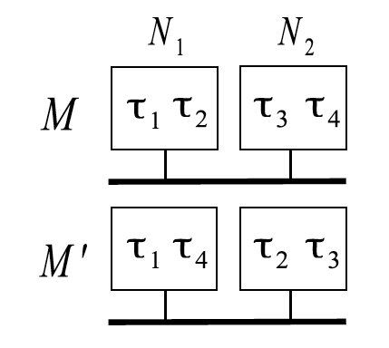
Motivational example: robustness
Robustness: the probability of all tasks being schedulable
  Without capturing uncertainty in WCETs: M’ is preferred.
  Capturing uncertainty in WCETs: M has much higher chances (93%) to be schedulable, compared to M’ (67%).
Notes:
Let’s present a motivational example to show the importance of modeling uncertainties.
Let’s assume we have two mapping alternatives, M and M’. In the case we don’t caturing uncertianty in WCETs, and calculate the degree of schedualbility by a single value, the expected WCET value, we have rM = -260, while, rM’ = -317, which means that M’ would be preferred, since a larger negative values means the solution is more schedulable.
However, we reach a different conclusion if we capture the uncertainties in wcets. The figure in the right hand side presents the degree of schedulability cpf’s for the two mappings. The probability of the mapping being schedulable P(rM’) is determined by the intersection of the cpf with the vertical line at point “0". As we can see, M has a better chance of being schedulable (93%) than M’ (67%), so actually choosing M instead of M’ is more “robust", i.e., it has a higher chance of being schedulable.
We define the robustness as the probability of all tasks being schedulable.

Slide 13
Motivational example: flexibility
Baseline functionality
Future scenarios
(×) Pareto-optimal solutions
Exhaustive search
(+) Straightforward Mapping, SFM
ignores uncertainty in WCETs
ignores future scenarios
Flexibility: the probability of all future scenarios being schedulable
Notes:
We also consider to model the uncertainties in functionality as flexibility. Let us consider the baseline functionality, and the future scenarios in the left Tables. We are interested to determine a mapping which maximizes robustness and flexibility. The Pareto-optimal solutions found after an exhaustive search, are depicted by (blue) ‘x’ in Figure. Pareto-optimal solutions are solutions which are not dominated by other solutions.
We have also plotted the SFM, which ignores uncertianties in WCETs and functionality, with a red plus (+), and we can see its robustness and flexibility are very low.
This example shows that it is important to take into account the uncertainties in both the WCET and functionality requirements.

Slide 14

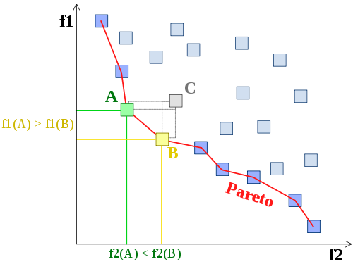
Multiobjective optimization
Cost function: multiple objectives
Two alternatives:
  Merge all design metrics into a single cost function by using a weighted sum then use meta-heuristics such as Tabu Search
  Perform a multi-objective optimization approach such as Genetic Algorithm, which determine a Pareto-front of solutions
Pareto-front (trade-off curve)
  Solutions are not dominated by each other
Notes:
When we consider simultaneously optimizing multiple design metrics, we can either merge all design metrics into a single objective function by using a weighted average, and determine one optimized solution, or we perform multiobjective optimization, which aims to determine Pareto-front of solutions.
In general, there are exact methods, such as integer/mixed linear program formulation, and heuristics, such as Tabu Search (TS) or Genetic Algorithm (GA), for solving the multiobjective optimization problems. In this project, we propose a Genetic Algorithm (GA)-based approach, to solve the current optimization problem.

Slide 15
Mapping for Robustness and Flexibility (MRF)
  Determining an optimal mapping is NP-hard
  (Non-deterministic-Polynomial-time hard)
Genetic algorithm-based approach: MRF
(Mapping for Robustness and Flexibility optimization)
  Non-dominated Sorting Genetic Algorithm-II
For each candidate solution M_{k}
  We calculate the robustness
  We calculate the flexibility based on the robustness of each M_{i}
    We have to know the mapping M_{i} of each future scenarios S_{i} on top of M_{k}
    We use a Greedy mapping approach to determine the M_{k}
    Greedy mapping M_{i} of each future scenarios S_{i} on top of M_{k}
      Only the tasks which are not in S₀ have to be mapped
      Greedy: tasks are sorted on utilization; mapped on the lowest utilized PE
Notes:
We decided to use an off-the-shell method, the Non-dominated Sorting Genetic Algorithm-II, due to its good performance and its simple implementation.
For each candidate solution Mk visited during the search, we calculate the robustness using the Kernel Smoothing Density Estimate (KSDE) technique (the details refer to my thesis, we don’t have time to present it now).
To calculate the flexibility we have to try and fit each future scenario on top of the baseline mapping. To have the most accurate calculation of felxibility we would need to use the optimal mapping for each future scenario, but that is time consuming. Instead, we use a greedy mapping for the future scenarios.

Slide 16
Experimental setup
Baseline scenario
  We have varied the size of the system from 22 tasks (S₀) and 3 PEs
  to 84 tasks (S₀) and 10 PEs
    4 real-life case studies from Embedded System Synthesis Benchmark Suite
    8 eight synthetic benchmarks generated using Task Graphs For Free
Future scenarios
  For each benchmark, we have four future scenarios
Implementation
  Matlab 2010 and run on an Intel Core i7 CPU 920 (2.67 GHz)
  NSGA-II parameters are tuned such that no improvements were seen
  after a very long runtime
Notes:
To evaluate the proposed approach we used 4 real-life case studies from Embedded System Synthesis Benchmark Suite 8 eight synthetic benchmarks generated using Task Graphs For Free. We have varied the size of the system from 22 tasks (S₀) and 3 PEs to 84 tasks (S₀) and 10 Pes. For each benchmark, we have four future scenarios.
I implemented the proposed optimization algorithm in Matlab 2010 and NSGA-II parameters are tuned such that no improvements were seen after a very long runtime.

Slide 17
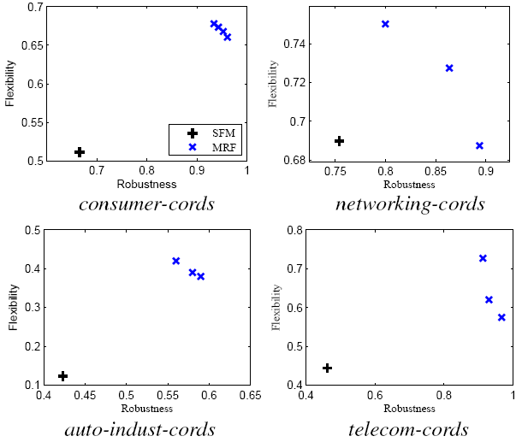
Experimental results: real-life case studies
  Conclusion: It is very important to model the uncertainties
  and to take them into account during design space exploration.
Notes:
We only show the experimental results of the real-life case studies here. In the resulting table, we have the number of PEs, number of tasks in the baseline and future scenarios, the values of robustness and flexibility by SFM and MRF. We also present a plot where we have compared the pareto-front obtained by MRF with SFM I have introduced before. We can see that SFM is not able to find robust and flexible solutions, whereas our MRF approach is able to find good quality solutions, which both robustness and flexibility are significantly increased compared to SFM.
This mapping problem has been extended to consider the architecture selection under uncertainties. Architecture selection means deciding the hardware components, their characteristic and their interconnections. Anyone interested can have a look on my thesis.

Slide 18
Outline
Introduction
Design for Robustness and Flexibility of Real-Time Distributed Applications during the Early Design Phases
Reliability-Aware Dynamic Energy Management for Fault-Tolerant Distributed Embedded Systems
Criticality-Aware Functionality Allocation for Distributed Real-Time Embedded Systems
Summary and contributions
Notes:
The second project is about ”reliability-aware dynamic energy management for fault-tolerant distributed embedded systems”.

Slide 19
Architecture model
A set of heterogeneous processing elements interconnected by a communication channel
Each processor element have a set of discrete operating modes
For each operating mode we know
Notes:
We consider hardware architectures consisting of a set N of heterogeneous processing elements and interconnected by a shared communication channel. The difference compared with the previous project is, we consider power-aware processing elements, which each PE have a set of operating modes, and for each operating mode we know the frequency, voltage, and power dissipation.

Slide 20
Application model
A set of periodic tasks
Transient faults are tolerated using task replication
  Number of replicas k_{i} (critical task: k_{i} > 0, non-critical task: k_{i} = 0)
Reliability goal R_{g}
  The system should have a reliability greater than Rg, otherwise it is not fault-tolerant (more replicas would be needed).
Notes:
We model the application as a set of periodic tasks. For each task, we know the worst-case execution time, period, and deadline. The chosen scheduling policy assigns an unique priority to each task. In this paper we are interested to tolerate transient faults using task replication. For each critical task, the number of replicas is specified, based on the reliability goal.
I do not have time to say details about the energy and reliability model used, which is presented in the thesis. I want to focus on the energy/reliability tradeoff model.

Slide 21

Energy/reliability trade-off model
  The fault rate increases exponentially when normalized voltage V and the normalized frequency F decreases
The equation is adapted from: D. Zhu and H. Aydin, “Reliability-Aware Energy Management for Periodic Real-Time Tasks”, IEEE Transactions on Computers, 58(10), pp. 1382 - 1397, 2009.
Notes:
With regard to energy minimization, the most common approach that allows trade-offs between energy and performance is Dynamic Voltage and Frequency Scaling (DVFS). which reduces the dynamic power dispassion by scaling down operational frequency and circuit supply voltage.
However, lowering the voltage to reduce energy consumption has been shown to increase the number of transient faults exponentially. The equation gives the tradeoff between performance and reliability. Lambda 0 is the transient fault rate for PE runs in its max speed operating mode, while lambda L is the increased transient fault rate for PE runs in a scaled operating mode.
The figure shows the fault rate increases exponentially when normalized voltage V and the normalized frequency F decreases, so switching the operating mode has an impact not only on performance and energy consumption, but also on the system reliability.

Slide 22
Problem formulation
Given:
  Application and architecture models
  Reliability goal and corresponding number of replicas for each task
Determine offline:
  the mapping of each task to processing element
  the operating mode for executing each task
Such that:
  all tasks meet their timing requirements
  the application reliability meets the given reliability goal
  the energy consumption of the system is minimized
Notes:
We have the problem formulation as follows…

Slide 23
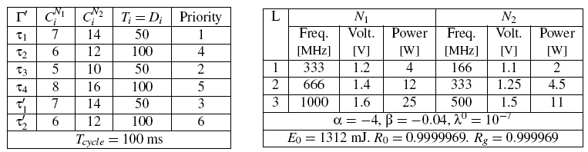
Motivational example
Application and architecture
Initial solution: no voltage and frequency scaling
  Runs all the tasks in the maximum speed operating mode and
  maps the tasks on the low power PEs.
The given reliability goal:
which means that we accept at most a 10 times decrease in reliability.
Notes:
Let us consider the example in the tables where we have a task set of six tasks (four tasks and two replicas) mapped on an architecture of two PEs. The WCETs, periods, deadlines and priorities of all tasks are presented in the left table. /tau_1 and /tau_2 are critical tasks and they are replicated once. The operating modes of the two PEs are given in the right table.
In the initial solution, instead of considering voltage and frequency scaling, we runs all the tasks in the maximum speed operating mode and maps the tasks on the low power PEs. E0 and R0 are the energy and reliability of initial solution S0. We have set Rg to 0.99960 by the specified equation, which means that we accept a probability of failure that is ten times greater than R0.

Slide 24
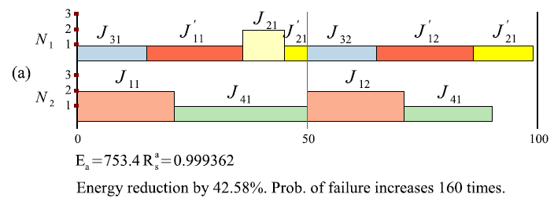
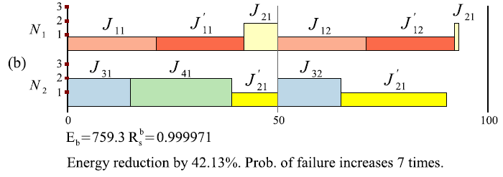
Motivational example: offline
Energy minimization without concern for reliability
Energy/reliability trade-off optimization
Notes:
Figure shows two alternatives to the offline synthesis problem. The offline synthesis has to decide the mapping and the operating mode for each task. In the figures, the mapping is indicated by placing the task on the timeline of the PE where it is mapped and the height of the rectangle indicates the operating mode. The offline scheduling has to assume that the tasks will execute up to their WCETs (the length of the rectangles in the timeline) and that all replicas are executed.
Fig(a) shows the solution Sa which minimizes the energy consumption without concerning for reliability. Sa meets all tasks’ deadlines and reduces the energy by 42%, compared to E0. However, Sa does not meet the system reliability goal. The probability of failure increases 160 times.
By carefully deciding the mapping M and operating modes L, it is possible to reduce the negative impact on reliability without a significant loss of energy savings. Another implementation, Sb, shown in Fig(b) fulfills all timing and reliability requirements, with only 0.45% loss in energy savings, compared to Sa.

Slide 25
Optimization strategy: offline synthesis
Optimization Problem
  NP-hard (Non-deterministic-Polynomial-time hard)
  Minimize the cost function:
Use a Tabu search-based algorithm to explore the design space
  Iteratively explores neighborhood solutions by performing
    mapping moves
    operating mode moves
Energy
Reliability
Schedulability
Notes:
Determining an optimal task mapping is a NP-hard problem. To solve the offline synthesis problem, we propose a TABU search-based approach. Tabu Search (TS) is an optimization metaheuristic which iteratively explores the solutions in the vicinity (neighborhood) of the current solution, selecting the ones which optimize the cost function.
We consider to merge the three design metrics into a single objective function by using a weighted average, where the first term is the energy consumption of running the implementation S, the second term is the reliability constraint and the third term represents the timing constraint. Instead of considering solutions which do not meet timing and reliability constraints as infeasible, and to ignore them during the design space exploration, we decided penalize such solutions in the cost function by giving large values, which allows us to explore infeasible regions of the search space and drive the search towards feasible regions.
Our TABU search-based approach iteratively explores neighborhood solutions by mapping moves and operating mode moves. We don’t have time to go into the details of the algorithm now, but I would like to mention that our proposed algorithm is efficient to determine the near optimal solution in a very reasonable time.

Slide 26
Experimental Results: offline synthesis
  Conclusion: we are able to reduce the negative impact of energy minimization on reliability with very little decrease in energy savings
Notes:
In one of the experiments we wanted to evaluate the quality of MVFS as the systems become larger. Table presents the experimental setup details and the results. We used five synthetic benchmarks of 10 to 105 tasks (including replicated tasks) mapped on architectures with 2 to 6 different types of PEs. The details of each test case are presented in columns 1–4.
The results obtained with MVFS (energy/reliability trade-off optimization) are presented in the last two columns. Alongside the MVFS results, we also present the results obtained with MVFS-(optimization without concern for reliability). As we can see from Table, columns 5 and 6, minimizing the energy without considering reliability leads to a dramatic increase in the probability of failure, which increases more than 100 times in most cases. However, our MVFS approach is able to keep the system reliability RS within the specified Rg, with very little loss in energy.

Slide 27
Outline
Introduction
Design for Robustness and Flexibility of Real-Time Distributed Applications during the Early Design Phases
Reliability-Aware Dynamic Energy Management for Fault-Tolerant Distributed Embedded Systems
Criticality-Aware Functionality Allocation for Distributed Real-Time Embedded Systems
Summary and contributions
Notes:
The third project I had done is about Criticality-Aware Functionality Allocation for Distributed Real-Time Embedded Systems.

Slide 28
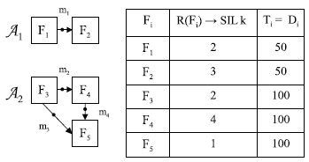
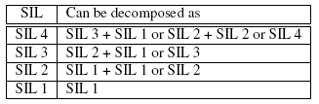
Function-to-task allocation
Design-level: applications are modeled as functional blocks.
Implementation-level: applications are modeled as a set of interacting tasks.
Safety-Integrity Levels (SILs): are assigned to functional blocks/tasks to capture the required level of risk reduction, from SIL 4 (most critical) to
SIL 0 (non critical).
Development and certification costs increase dramatically with SILs.
Trade off between cost and schedulability.
SIL decomposition based on the coresponding certification standards.
ISO 26262
Notes:
In the application model, we consider, in design-level, applications are modeled as a graph of functional blocks, where each node Fi is a functional block, and an edge from Fi to Fj denotes a data dependency. In implmentation-level, applications are modeled as a set of interacting tasks, which is the same as in the previously projects.
During the engineering of a safety-critical system, the risks are assessed and the appropriate risk control measures are introduced to reduce the risk to an acceptable level. A Safety-Integrity Level (SIL) is allocated to each safety function and captures the required level of risk reduction, from SIL 4 (most critical) to SIL 0 (non-critical).
Certification standards refer to this process as “SIL decomposition” . Table shows the example of the SIL decomposition from ISO 262621. Such a decomposition guide amounts to a “SIL algebra” , i.e., the SIL of the safety function is the sum of the SILs of the redundant tasks.
Decomposing a safety function of a higher SIL into several redundant tasks of lower SILs can reduce the development and certification costs, but increasing the timing requirements in finishing the more tasks. Therefore the tradeoff analysis for function to task have to be considered.

Slide 29
Problem formulation
Given:
  Application and architecture models
  The library of function-to-task decomposition
  The library of architecture implementations for the PEs
Determine an implementation:
  the function-to-task decomposition
  the mapping of tasks to PEs
  the types of PEs in the architecture
Such that:
  total costs are minimized
  the schedulability of the applications maximized
  the requirements of safety and integrity are satisfied
Notes:
We have the problem formulation as follows...

Slide 30
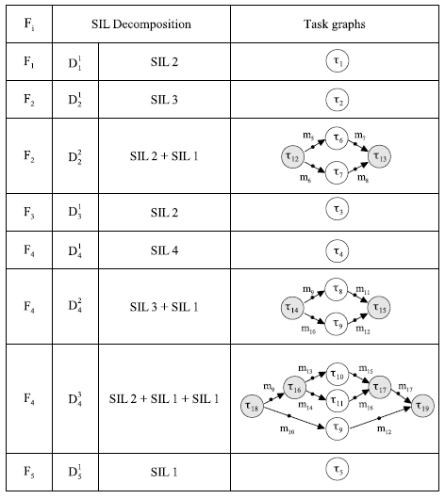
Motivational example: decomposition library
Notes:
Let’s consider the library of function-to-task decomposition in the table. we have five functional blocks, F1 to F5, with different SIL requirements, periods and deadlines, will be implemented on an architecture of three Pes.
The SIL decomposition follows the corresponding certifications, ISO 262621 in current case. For example, there are three decomposition options for D(F4) in Table: D14 in one task /tau_4 (SIL 4), D24 in two tasks, namely /tau_8 (SIL 3) and /tau_9 (SIL 1), and D34 in three tasks /tau_10 of SIL 2, /tau_11 of SIL 1, and /tau_9 of SIL 1. Note that in the decomposition option D24, the sum of the WCETs of the decomposed tasks, i.e., /tau_8, /tau_9, /tau_14, /tau_15, has a value of 44, compared to the value of 20 for the single task /tau_4 in D14.

Slide 31
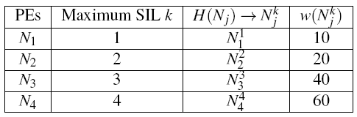
Motivational example: hardware component library
The unit cost increases with the increased reliability:
use lowest cost PEs which provide required reliability
Notes:
The available hardware components are shown in the table, w is the unit cost of PE Nj with a reliability corresponding to a SIL k. Note that we will always use in an architecture the lowest cost PEs available, which have the required reliability to host the highest-criticality task mapped on that PE, and that the unit cost increases with increased reliability.

Slide 32
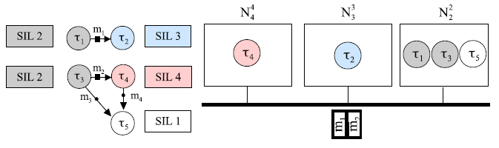
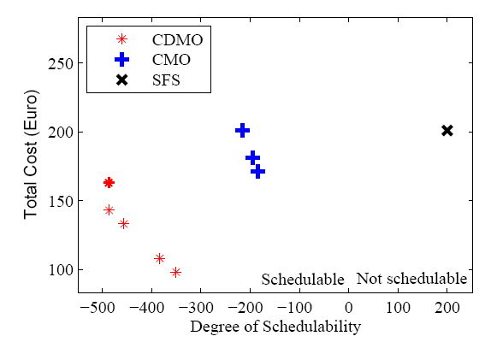
Motivational example: SFS and optimized results
Straightforward Solution (SFS):
  Do not decompose the functional blocks into
  tasks with lower SILs
  Cluster all tasks based on SILs for the mapping
Criticality-Aware Mapping Optimization (CMO):
  Optimize the mapping
Criticality-Aware Functional Decomposition and Mapping Optimization (CDMO):
  Optimize the functional decomposition
  Optimize the mapping
Notes:
One possible solution to this problem is presented in the top figure. We call this solution the “Straightforward Solution”, or “SFS”. This is a solution where: (1) we do not decompose the functional blocks into tasks with lower SILs (2) we consider a simple mapping where we cluster all tasks based on SILs. The Fig shows the resulted tasks graphs after decomposition, the mapping of tasks on PEs, and which PE version we have used.
The SFS is also shown in the bottom Fig, using a “x”, where we display a graph with the resulting values of two objective functions, total cost (y-axis) and schedulability (xaxis). and the unit costs of PEs), the smaller values means lower costs. For the schedulability, values above zero means “not schedulable”, whereas values below zero means that the solution is schedulable, and the smaller the value, the higher the schedulability. As we can see from the figure. SFS has a high cost and it is not schedulable. This is not surprising, considering that it is know that mapping decisions have a strong impact on solution quality, and SFS does not optimize the mapping.
Fig also shows solutions that optimize the mapping. “Criticality-Aware Mapping Optimization” (CMO) uses the same simple approach for decomposition as SFS, but optimize the mapping aiming at improving the objective functions. CMO solutions, determined after exhaustive search, are Pareto-optimal solutions. As we can see from Fig, where each CMO solution is depicted with a blue “+”, by optimizing the mapping, we are able find schedulable solutions. However, the cost remains high.
We have proposed an optimization approach called “Criticality-Aware Functional Decomposition and Mapping Optimization” (CDMO), which decides the functional decomposition, the mapping of tasks to PEs and the types of PEs such that our design objectives are optimized. CDMO solutions are found after exhaustive search as well. They are shown in Fig using red “*”. As we can see from the figure, by carefully deciding on the function-to-task decomposition, we are able to significantly reduce the costs, and further improve the schedulability, compared with CMO which does not optimize the function-to-task decomposition.

Slide 33
Optimization strategy
  Optimization problem is NP-hard
  (Non-deterministic-Polynomial-time hard)
Genetic algorithm-based approach, called CDMO
(Criticality-aware functional Decomposition and task Mapping Optimization)
  Non-dominated Sorting Genetic Algorithm-II
  For each candidate implementation S_{i}
  We calculate the degree of schedulability
  We calculate the total cost that includes the unit cost of the PEs and the development and certification costs of software tasks.
Notes:
We propose a Generic Algorithm (GA)-based approach, called CDMO (Criticality-aware functional Decomposition and task Mapping Optimization), to solve this two-objective (degree of schedulability and total cost) optimization problem.

Slide 34
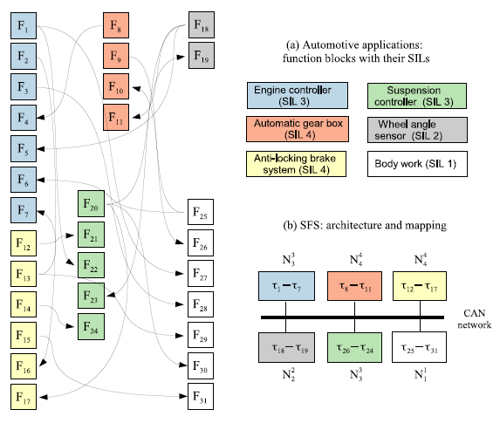
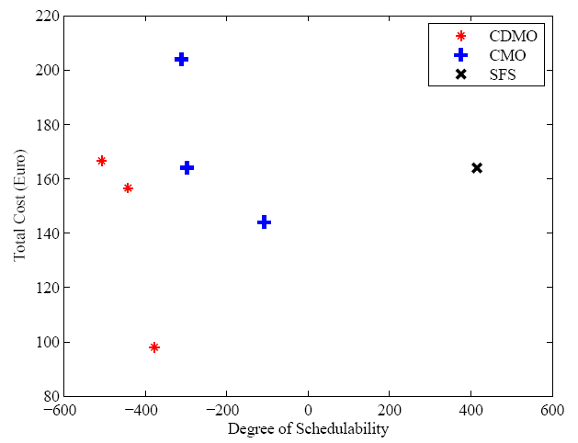
Experimental results: real-life case study
Conclusion: By taking into account SIL decomposition,
we are able to find schedulable solutions at a reduced cost.
Notes:
We use a real-life case study, the automotive applications, to evaluate our proposed optimization strategy.
We show the functional blocks with their SILs, SFS and the resulting figure which compares the SFS with the optimized solutions in the figure.
The conclusion is that our automatic tool can perform safety function decomposition which lead to cheaper and schedulable implementations. The engineer can choose from the Pareto-front solutions that a desired trade-off between cost and schedulability.

Slide 35
Outline
Introduction
Design for Robustness and Flexibility of Real-Time Distributed Applications during the Early Design Phases
Reliability-Aware Dynamic Energy Management for Fault-Tolerant Distributed Embedded Systems
Criticality-Aware Functionality Allocation for Distributed Real-Time Embedded Systems
Summary and contributions
Notes:
The third project I had done is about Criticality-Aware Functionality Allocation for Distributed Real-Time Embedded Systems.

Slide 36
Summary
I addressed the architecture selection and the mapping of hard real-time applications on distributed heterogeneous architectures.
  I modeled the uncertainties in WCETs, functionality requirements, and hardware component costs, during the early design phases.
I addressed the mapping, voltage and frequency scaling for fault-tolerant hard real-time applications mapped on distributed embedded systems.
  I proposed both offline and online approaches that can take reliability into account when performing voltage and frequency scaling.
I addressed the function-to-task allocation and task mapping of mixed-criticality applications on distributed architectures.
  I took into account safety and integrity requirements while performing functional decomposition and architecture selection.

Slide 37
Contributions
I have addressed competing design metrics, and to support the designer making early design decisions.
I have proposed methods to perform automatic design space exploration for design of embedded systems.
The implemented design space exploration tools are able to determine good quality solutions in a reasonable time.
Notes:
In general...

Slide 38
Thank You

