Slide 1
Writing strong object-oriented applications
Copenhagen, November 2009
Version: 1.0
Status: Final
Author: Thomas Koefoed
tsk@netcompany.com

Slide 2
Agenda
Introduction and motivation
Coupling
Cohesion
Test-driven development
Advanced topics
Questions and evaluation

Slide 3
Personal introduction
Thomas Koefoed, 27, Senior Architect at Netcompany
Graduated as Master of Informatics from Technical University of Denmark, March 2007
Roles on Netcompany projects:
  Lead Developer (primarily on .NET)
  Software architect
  Technical architect
Netcompany delivers business-critical applications and system integration for medium-or-large companies, primarily in Denmark.

Slide 4
Why object-orientation?
Encapsulating complexity and reuse of code
  Switch of technology is easily implemented
  Adding or optimizing code-units can be done with little effort
Applications are easier to test
  Object-orientation promotes cohesion → Test complexity is reduced
  Test-frameworks exist and simplifies
Patterns and best-practices provide common development terminology
  Reduces complexity of reading and understanding of new code
  Proven solutions for a wide range of known problems
Etc.

Slide 5
Agenda
Introduction and motivation
Coupling
Cohesion
Test-driven development
Advanced topics
Questions and evaluation

Slide 6
What is coupling?
”The ability of the design to support replacement of components, without having to change the implementation of related components”

Slide 7
Real-life example 1
Tightly coupled application component
One (business-critical) use-case implemented by one(!) method in a single class
  Approximately 10000 lines of code
  Size of source-code file was the same as a one-minute-MP3 file
  No custom datatypes, only programming language simple types (int, string etc.)
The requirements to the component changed
  Functionality should now support new type of business and have the old-type of business removed
  All code in method subject to change
  Estimate of build (assuming OO-design): 1500 man hours
  Reality of build (no OO-design): > 7000 man hours

Slide 8
Real life example 2
Loosely coupling overkill
Development of case-worker portal
  To be used for one client only.
  Limited functionality
  Functionality is almost certainly not going to change radically for the next 10 years
  Layout has been decided to be web-based (by the management)
Solution
  VERY generic case-worker framework
  Fully configurable and loosely coupled – ready for new clients, technologies
  Many many abstract classes and interfaces defines the layers of the architecture
  Estimated man hours: 40000 (estimated specialized solution: 10000 hours)

Slide 9
Cost of tightly coupled systems
Time
Maintenance costs
Conclusions:
Analyse the need of the extent of loosely coupling
Implement loose coupling where needed.
Development costs
Extent of tight coupling

Slide 10
Tightly coupled system (bicycle dealer class diagram)
Made-up example
Presentation layer
Direct reference to the UI implementation from all manager classes to accommodate updates to the UI
April 2007, WPF GUI should be used
due to enhanced UI requirements
Windows Forms
GUI
Business logic layer
Software architect reports that
700 man hours of work is
needed to reimplement the
database commands
February 2008:
Software architect
is fired
Customer
Manager
Bicycle part
Manager
40 other
manager
classes
Bicycle Manager
Software architect reports that
350 man hours of work are needed
to implement and test dependencies
within the business logic layer to
accomodate the new GUI
Oracle database
January 2008, Microsoft SQL Server 2008
should be used due to management decision

Slide 11
Loosely coupled system (bicycle dealer class diagram)
Made-up example
Presentation layer
April 2007, WPF GUI should be used
due to enhanced UI requirements
Windows Forms
GUI
Implements
Business logic layer
Referenced by all manager classes when updates to the UI should be performed
February 2008:
Software architect
is promoted
<Interface>
Observer
Customer
Manager
Bicycle part
Manager
40 other
manager
classes
Bicycle Manager
Software architect delivers the
business layer package to the UI
team and reports that 0 hours of
work is required for the business
layer component
Data access layer
Hibernate
Software architect reports that
4 hours of work is required to
reconfigure the data access component
to accommodate the change of
database technology
January 2008, Microsoft SQL Server 2008
should be used due to management decision
Oracle
database

Slide 12
Loose coupling
Things to look for
References to a class from a large number of client classes
  Use interfaces to define the contract that the single class should fulfill and let the client classes reference the interface rather than the implementation
Technology specific code, such as DB commands, scattered in many classes
  Encapsulate code in classes in a seperate package of the application
  Even better: Use 3rd party or standard frameworks/components
References to methods in packages in a higher layer of the architecture
  Use the observer pattern shown in the bicycle dealer example
  There should ALWAYS only be references from a layer to its immediate successor down the architecture (see bicycle dealer example).

Slide 13
Agenda
Introduction and motivation
Coupling
Cohesion
Test-driven development
Advanced topics
Questions and evaluation

Slide 14
What is cohesion?
”Assigning the proper responsibilities to classes and methods, ensuring as much reusability and as little redundancy as possible”

Slide 15
Real-life example (same as earlier)
Weakly cohessed application component
One (business-critical) use-case implemented by one(!) method in a single class
  Approximately 10000 lines of code
  Size of source-code file was the same as a one-minute-MP3 file
  No custom datatypes, only programming language simple types (int, string etc.)
The requirements to the component changed and the component has been reimplemented
  All uses of the method should be tested
  Input and expected output is almost impossible to analyse and produce
  Estimate of test (based on OO-assumption): 750 hours
  Reality of test: ? ☺

Slide 16
Cost of weakly cohesed applications
Time
Testing costs
Maintenance costs
Development costs
Conclusion:
Always make your applications as strongly Cohesed as possible
Extent of weak cohesion

Slide 17
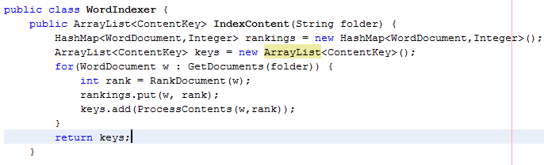
Weakly cohesed system
February, 2009:
Due to changed security and presentation
Requirements, the indexer must now also support
Security trimming. The indexing algorithm should,
Therefore be able to access the ACL of the file
And incorporate this into the algorithm
< Interface >
Indexer
Word indexer
Excel indexer
PDF Indexer
70 other indexer
types
The software architect reports that 100 man hours
should be allocated for the enhancement
Implements Indexer
Each implementing class implements a similar algorithm, where only the WordDocument type is replaced by similar specialized types (ExcelDocument, PDF Document etc.)

Slide 18
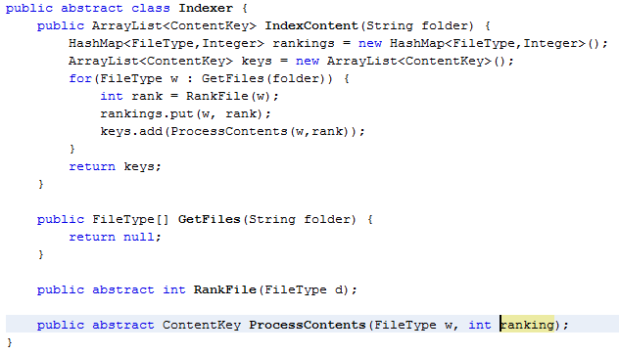
Strongly cohesed system
The software architect reports that 12 man hours
should be allocated for the enhancement
<Implementation>
All specific indexers implements
just the operations that are specific
to their file types. The index algorithm
is implemented in the abstract base
class
February, 2009:
Due to changed security and presentation
Requirements, the indexer must now also support
Security trimming. The indexing algorithm should,
Therefore be able to access the ACL of the file
And incorporate this into the algorithm
< Abstract >
Indexer
Word indexer
Excel indexer
PDF Indexer
70 other indexer
types

Slide 19
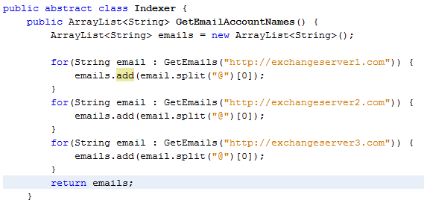

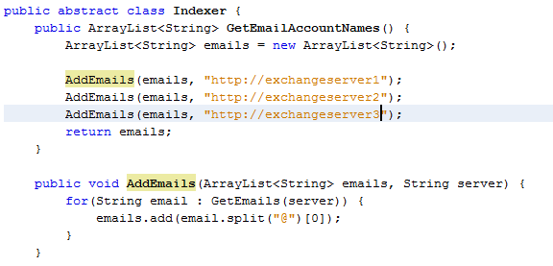

Keep methods short
What happens if the processing logic for email accounts are changed? How many places in the code should be changed?
This design is easier to test and read, as its responsibilities are clearer defined

Slide 20
Cohesion
Things to look for
Redundant implementations among classes
  Usually created by copy-pasting between classes
  Use object oriented concepts like base- and abstract classes to eliminate redundancy between classes.
Classes and methods are difficult to read and understand
  Make classes and methods responsible only for what they are intended to
Long methods exist in one or more classes
  Extract code-pieces to private methods to improve readability
Implementations of an algorithm are scattered within the class.
  Can be refactored to private methods to empower stronger cohesion and thereby better testing

Slide 21
Agenda
Introduction and motivation
Coupling
Cohesion
Test-driven development
Advanced topics
Questions and evaluation

Slide 22
What is test driven development?
Unit tests are created for all business logic
  Unit tests are tests that are automatically run and verified by a test-engine
  Usually there is a 1-1 relationship between a method and a unit test
Unit tests are written before the business logic is implemented
  Seems irrational and irritating at first
  Enforces the programmer to think about each methods responsibility
  Promotes the cohesion of the design (if the programmer cannot write the test before the implementation, the business logic method is probably to complex and should be broken down into more methods)
Unit tests verifies the validity of methods that are reimplemented
  Methods tend to be reimplemented due to performance bottlenecks, change of technology or other unexpected issue.

Slide 23
Why test driven development?
Is proven to raise the level of cohesion
Enforces the developer to think in method signatures rather in method implementation
Ensures the quality of the developed software. Also when methods are reimplemented
Identifies who, in a team of developers, has introduced errors.

Slide 24
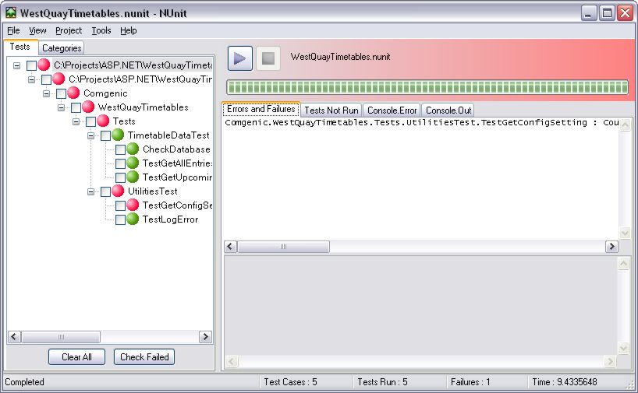
Implementation of test driven development
Use test frameworks such as Junit
Design unit tests before method implementations
Unit tests must be completely independent of existing data.
  Use mocking if necessary
Ensure that unit-tests are run at each checkin of the code to a source control
Use IDE plugins for unit-testing

Slide 25
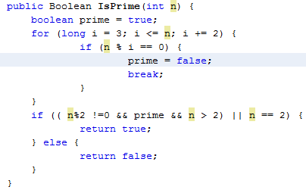
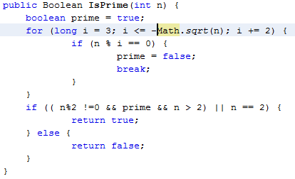
Example of test driven developmen
The minus inserted by accident would be very hard to catch, if no unit test existed for the method

Slide 26
Agenda
Introduction and motivation
Coupling
Cohesion
Test-driven development
Advanced topics
Questions and evaluation

Slide 27
Reflection
What is reflection?
Types are normally loaded when the runtime (JVM) loads the application.
Members are normally invoked on the loaded types by the JVM
Reflection makes dynamically loading of types and invoking type-members possible.
  person._name = ”Marc”
  Typeof(person).GetField(”_name”).SetValue(person, ”Marc”);
Reflection performs worse than typesafe loading and cannot be verified by the compiler, and should thus be used appropriately.
Reflection can be used to ”hack” 3rd party component, whose scope denies access to needed functionality.
  Reflection can be used to invoke private and protected members.
  Use with extreme caution!
Reflection is ideal for provider frameworks.

Slide 28
Example of reflection
A membership provider framework
<MembershipProviders toBeUsed=”custom” >
<MembershipProvider name=”custom”
type=”Company.Providers.CustomXML”/>
</MembershipProvders>
Contains methods such as:
GetUser(string);
ValidatePassword(string);
< Interface >
MembershipProvider
Login page
ActiveDirectoryMembershipProvider
OracleMembershipProvider
CustomXMLMembershipProvider

Slide 29
Design patterns
Design patterns are templated ways of solving a given functional or technical design challenge
Design patterns are proven ways of designing components in an application
Design patterns enforces loose coupling and/or strong cohesion
Design patterns should only be applied where necessary
  Sometimes the flexibility they provide is not necessary (case-worker example)
Design patterns ease the process of new developers reading and understanding code in the application

Slide 30
Examples on design patterns
Observer (shown in first bicycle dealership example)
Template method (shown in second bicycle dealership example)
Visitor (can be used to apply different rendering logic to the application)
Abstract factory (can be used to create sets of related objects. An example is rendering controls in different environments)
Singleton (used to create an application wide single-instance of an object. An example is a cache).
Design pattern bible: ”Gang of four”-book
  Solid foundation to improve OO skills
  Handbook assist when facing OO-challenges

Slide 31
Agenda
Introduction and motivation
Coupling
Cohesion
Test-driven development
Advanced topics
Questions and evaluation

Slide 32
Evaluation (handouts in danish)
”Det faglige indhold” (The educational content)
  The lecture matches the educational level of the course
  The subject was relevant to the course
  The lecture helps my understanding of the course
  The lecture is relevant according to my wishes for a future job
”Formidling” (Presentation technique)
  The form and agenda of the lecture
  The amount of content of the lecture
  The ability of the lecturer to explain the subject
  The motivation of the lecturer
  The possibility to ask questions during and after the lecture
”Gæsteforelæsningen generelt” (General)
  Your general evaluation of the lecture
Netcompany
  Would you be interested in meeting Netcompany in other contexts?
  If yes, then which?
Other comments and suggestions
Grade between 1 and 5, where
  1 is very unsatisfied
  5 is very satisfied

